Slide 1
Archer’s Physical Development
Pascal Colmaire – WA Development & Education Director

Slide 2
Physical Developments
Targeted developments :
Efficient cardio functionality
Control of the whole vertical support apparatus / Static posture
Control on the specific efforts (mastering)
High level of proprioception
Good join mobility and an equally good flexibility.
Pascal Colmaire – Development & Education Director of WA
Notes:
A good efficiency of the cardio circulating functionality to maintain or restore as fast as possible a Homeostasis condition.
A control as much as possible ergonomic (effective and precise) of the whole vertical support apparatus from the head to the feet through all the kinetic chain articulations.
The control on the body axis considered as active (the horizontal one) which is in fact the complex to touch with the bow.
An excellent conditioning of the self- acceptor and hetero-acceptor channels and so of all mechanical and sensorial receivers which allow the handling of the great number of endogen and hexogen elements with absolute precision and for long periods of time.
A good join mobility and an equally good flexibility.

Slide 3
Physical Developments
Content of the physical program
Cardiac frequency
Strength: firm trunk
Yoga or equivalent
Strength: Various types
Strength: Specific
Stretching
Body Balance: General
Body Balance: Specific
Cardio: various sources of energy
Pascal Colmaire – Development & Education Director of WA

Slide 4
Physical Developments
Basis of Physical training
Psychomotor developments are fundamental in archery.
Capacity to perceive and to recognize the body position in the space and the degree of contraction of the muscles, even without the possibility to watch at them.
Tobe able to integrate the largest number of information to transfer that on the different operational levels.
To be able to activate procedures of self regulation with continuous adaptations.
Are recommended: Yoga, sophrology, classical dance…
Pascal Colmaire – Development & Education Director of WA
Notes:
As a consequence a fundamental part of the physical preparation in archery is represented by the “psychomotor” sphere and more by the continuous research of the integration between the development of different abilities and the combination of the conditional physical qualities with the coordinative ones.
Therefore we can define the archer as a cybernetic complex, that is an organism able to activate procedures of self regulation with continuous adaptation controls where adaptation controls mean control laws to allow a self modification of the parameters to follow the modification that the “system “must meet with during its function.
As matter of fact the elements characterizing the archer activity refer to the decoding of self- acceptor and hetero-acceptor signals to an important segmental coordination, to the spatial and temporal orientation. In addition the self projection is enlarged by the presence of a tool (the bow).
As much the ability to decode the situations and the sensations (sensorial or material) will be increased as higher will be the level of the ability achieved by the athlete.
The “cybernetic complex” must be able to integrate the largest number of information to transfer that on the different operational levels.

Slide 5
Physical Developments
Physical training principles
Variety and adaptability
Alternation of the training exercises
Avoid stereotypical motor formation.
Pascal Colmaire – Development & Education Director of WA
Notes:
Therefore there is the need to setup a physical preparation with characteristic of multilateralism and multivalency mainly if the training is dedicated to young people with a growing motor system.
In addition the variety and alternation of the training exercises given to the athletes are of fundamental importance.
These training exercises allow a continuous and prominent conditional and coordinative adaptation without risks of stereotypical motor formation.

Slide 6
Physical Developments
Content of the physical program
Cardiac frequency
Strength: firm trunk
Yoga or equivalent
Strength: Various types
Strength: Specific
Stretching
Body Balance: General
Body Balance: Specific
Cardio: various sources of energy
Pascal Colmaire – Development & Education Director of WA
Notes:
Let’s start with the cardio system

Slide 7
Physical Developments
Efficient cardio functionality
For archery around 60 percent of the maximal frequency - Karvonen formula : Cardiac frequency (cf)
(cfmax – cf at rest) x 0.6 (60% intensity)+ cf at rest
Objective = to maintain constant the cardio frequency at the preselected target.
When improvements, increase from 60 to 65%, to reach a maximum of 80% of the maximal cardiac frequency.
Start with 10 min of running or fast walking session, then increase up to 30/40 min.
Pascal Colmaire – Development & Education Director of WA
Notes:
Karvonen formula) it's possible to define with a simply and with enough precision the cardiac frequency to which the aerobic physical activity must be carried on, considering that the percent of the cardiac efficiency moves between 50 to 80 percent of the maximal cardiac frequency. In our case we would say that a percent around 60 percent of the maximal frequency is the optimum (certainly for the top level athletes this value moves to higher levels):
(cfmax – cf at rest) x percent intensity 0,6 if 60% + cf at rest to simply define with enough precision
If the subject has already a good level of physical efficiency it is possible to start with 10 min of running than increasing the time up to 30/40 min; in case of the subject not susceptible, or not trained, it is better to start with a fast walking session.
The athlete should not increase the speed which will increase automatically with the efficiency of the cardio vascular system. In fact, making equal the physical exertion and the engagement, the cardio pulses will decrease and consequently to maintain the pulse at the preselected level the athlete will automatically increase the speed.

Slide 8
Physical Developments
Content of the physical program
Cardiac frequency
Strength: firm trunk
Yoga or equivalent
Strength: Various types
Strength: Specific
Stretching
Body Balance: General
Body Balance: Specific
Cardio: various sources of energy
Pascal Colmaire – Development & Education Director of WA
Notes:
And now strengthening of the middle body

Slide 9
Physical Developments
The trunk muscular For stable and durable positions through:
STATIC POSTURES
SEMI-STATIC POSTURES
STATIC UNSTABLE POSTURES
WALKS WITH LOADING IN SUSPENSION
POSTURE CORRECTIONS AT MODIFIED EQUILIBRIUM
STRENGTHENING
Pascal Colmaire – Development & Education Director of WA
Notes:
Now let’s move to the core muscle improvement. We will cover 6 possibilities to improve the strength of the main body, i.e. the whole vertical support apparatus from the head to the feet

Slide 10
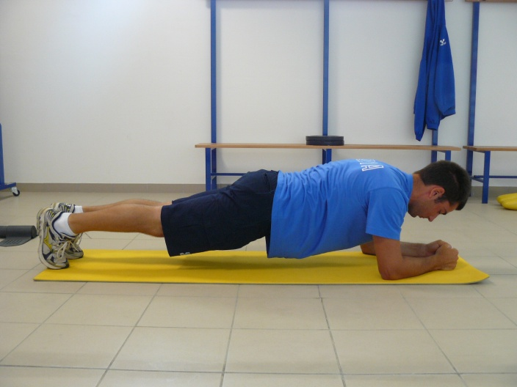
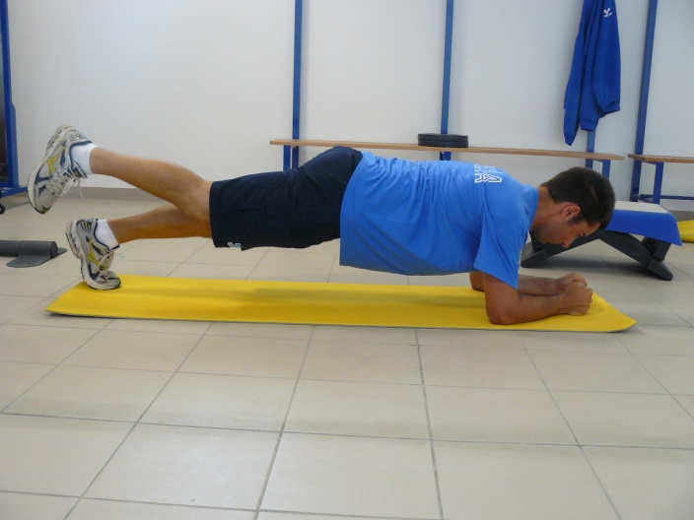
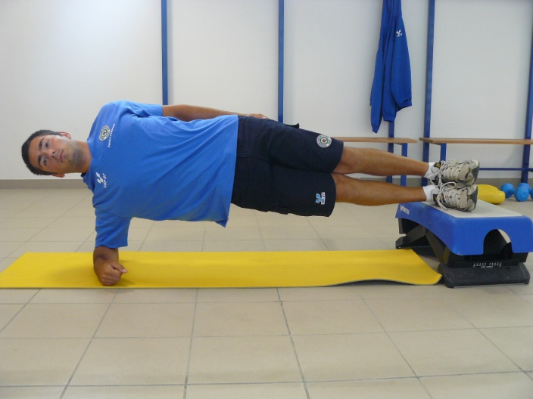
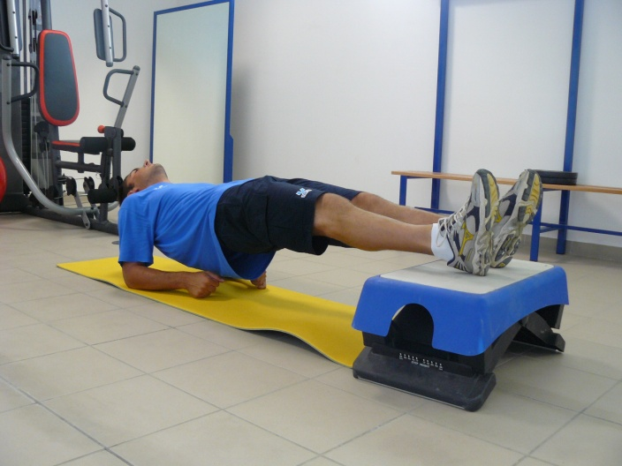
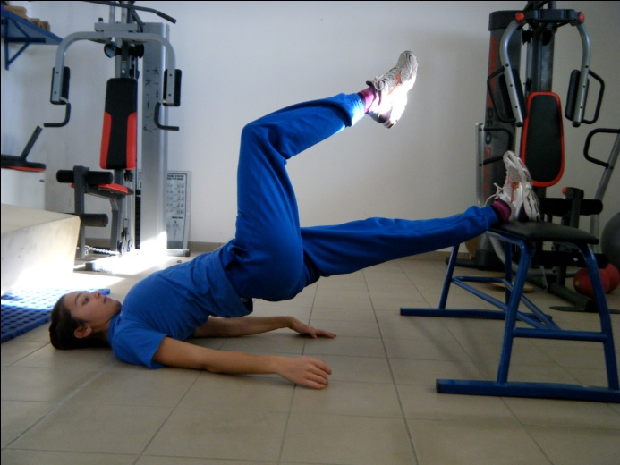
Physical Developments
The trunk muscular
STATIC POSTURES on FLOOR
2-3 series) between 15 “ to 1’ for the prone or supine positions
between 15” to 40”for the laterals and the three support prone position
To maintain aligned: ankle-knee-hip-shoulder-head
Pascal Colmaire
Development & Education Director of WA
Notes:
Self explanatory, but not limited to these few examples

Slide 11
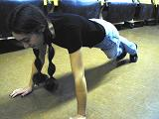
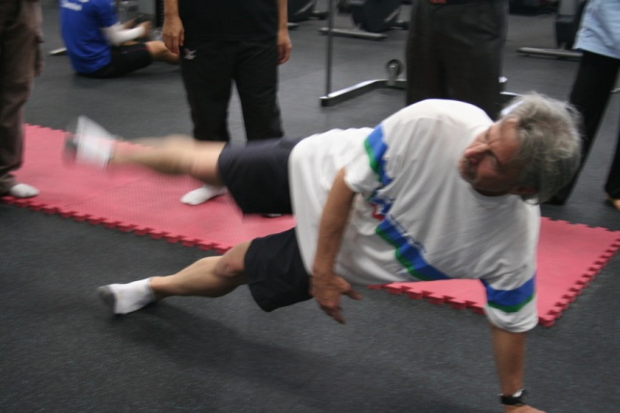
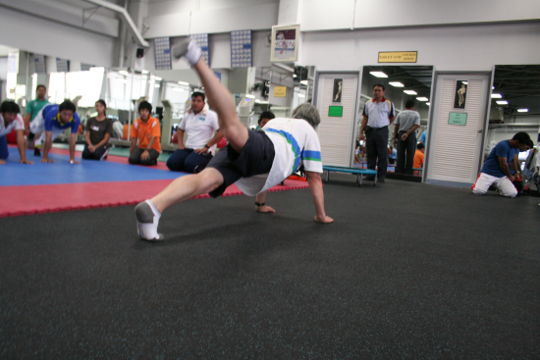
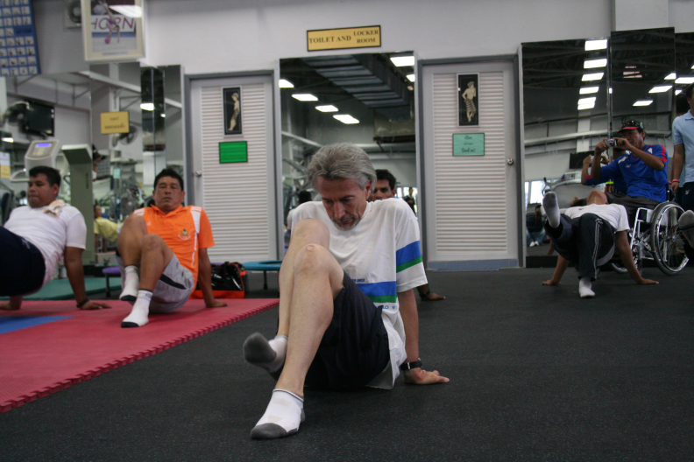
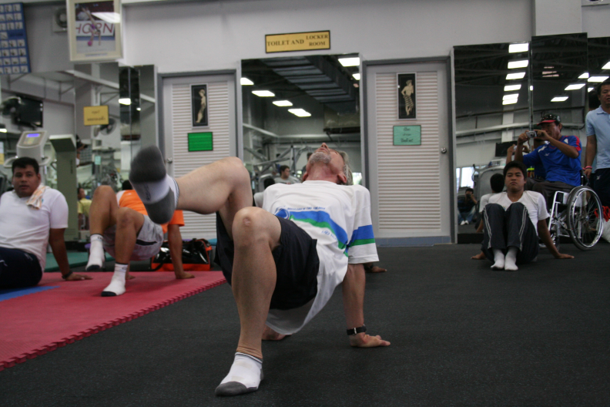
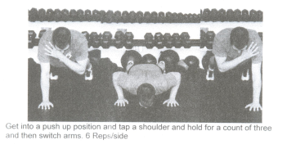
Physical Developments
The trunk muscular
SEMI-STATIC POSTURES on FLOOR
Add Blades push-up
2-3 series between 15” to 40”
To maintain aligned: ankle-knee-hip-shoulder-head
Pascal Colmaire – Development & Education Director of WA
Notes:
Self explanatory, but not limited to these few examples

Slide 12
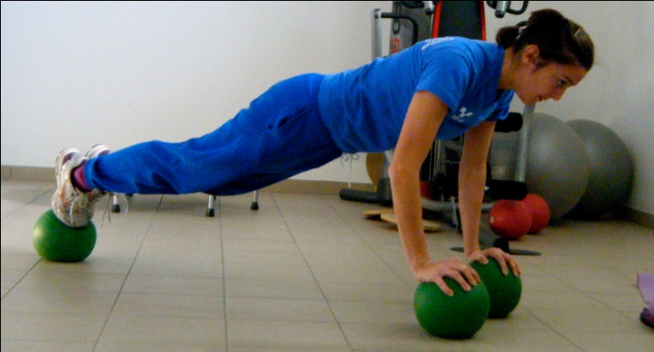
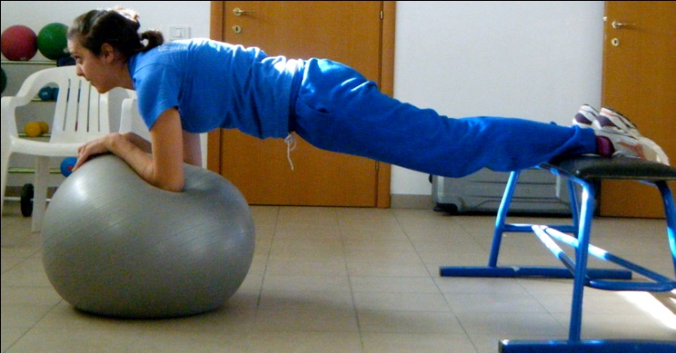
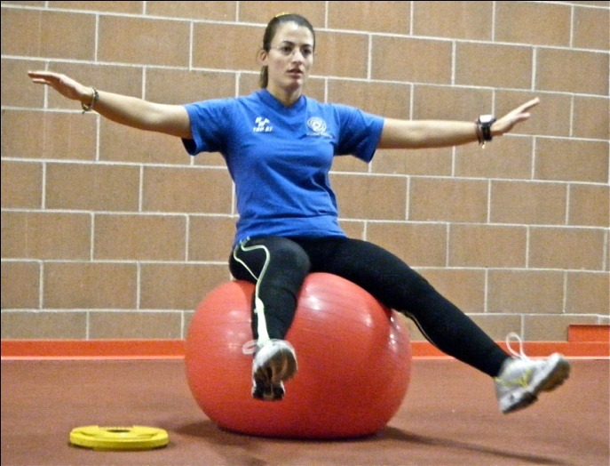
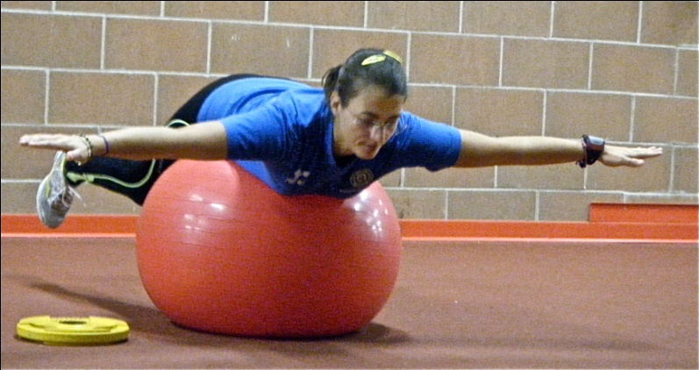
Physical Developments
The trunk muscular
STATIC UNSTABLE POSTURES
Pascal Colmaire – Development & Education Director of WA
Notes:
Self explanatory, but not limited to these few examples

Slide 13
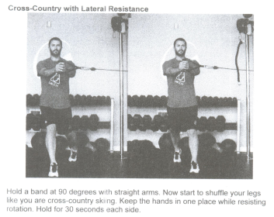
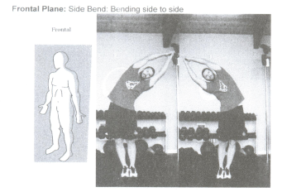
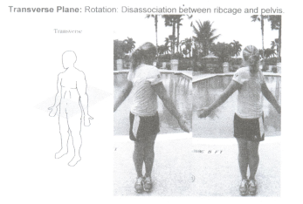
Physical Developments
The trunk muscular
STATIC effort (Isometric)
Pascal Colmaire – Development & Education Director of WA
Notes:
Self explanatory, but not limited to these few examples

Slide 14
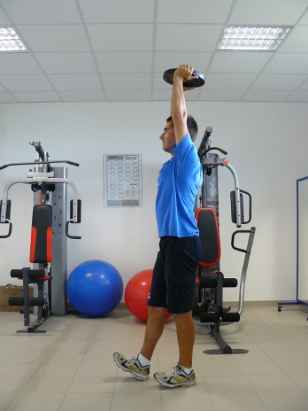
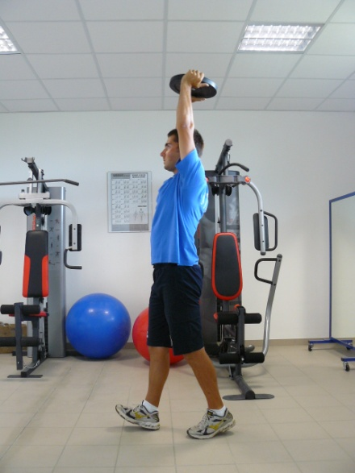
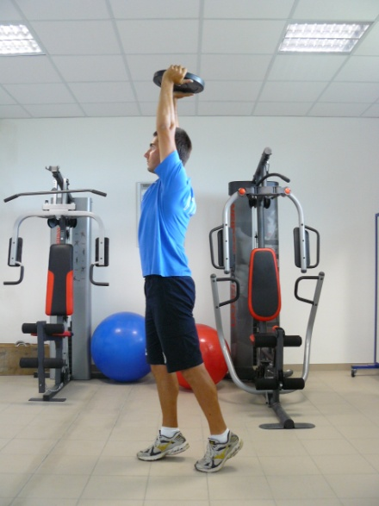
Physical Developments
The trunk muscular
WALKS WITH LOADING IN SUSPENSION
Total involvement of the whole supporting muscles, starting from feet moving to the lower limbs to gluteus to the back and to the abdomen up to the neck muscles.
Pascal Colmaire – Development & Education Director of WA
Notes:
Self explanatory, but not limited to this example

Slide 15
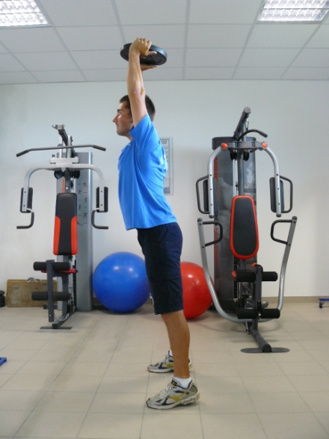
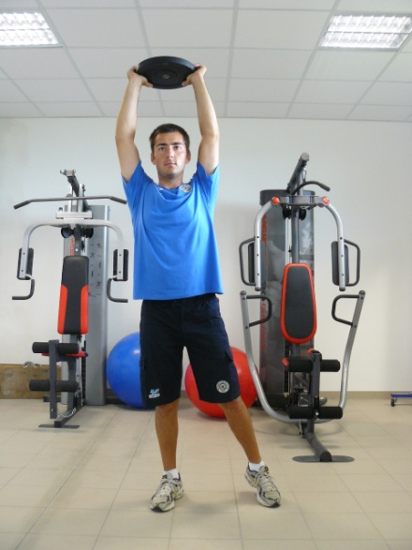
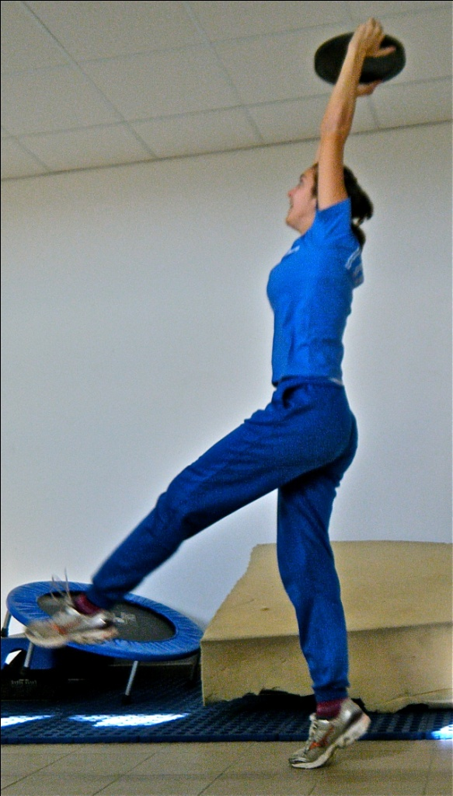
Physical Developments
The trunk muscular
POSTURE CORRECTIONS AT MODIFIED EQUILIBRIUM
Through a voluntary loss of the equilibrium on the front-back plane or on the lateral one with a subsequent recovery trough a sequence of muscular contractions without losing the complete alignment of the posture
Pascal Colmaire – Development & Education Director of WA
Notes:
Self explanatory, but not limited to these few examples

Slide 16
Physical Developments
Content of the physical program
Cardiac frequency
Strength: firm trunk
Yoga or equivalent
Strength: Various types
Strength: Specific
Stretching
Body Balance: General
Body Balance: Specific
Cardio: various sources of energy
Pascal Colmaire – Development & Education Director of WA
Notes:
The body balance can be improved through two set of exercises:
With bow in hands – let’s call this set “Specific Body balance”
Out of archery - let’s call this set “General Body Balance

Slide 17
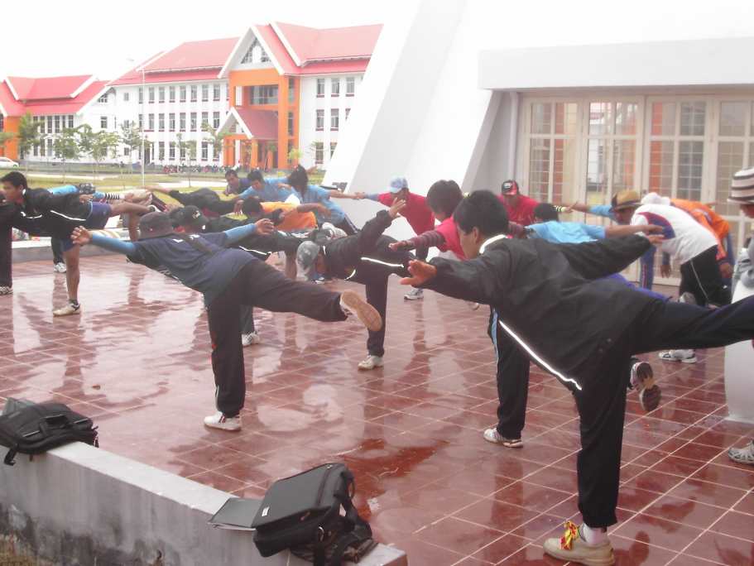
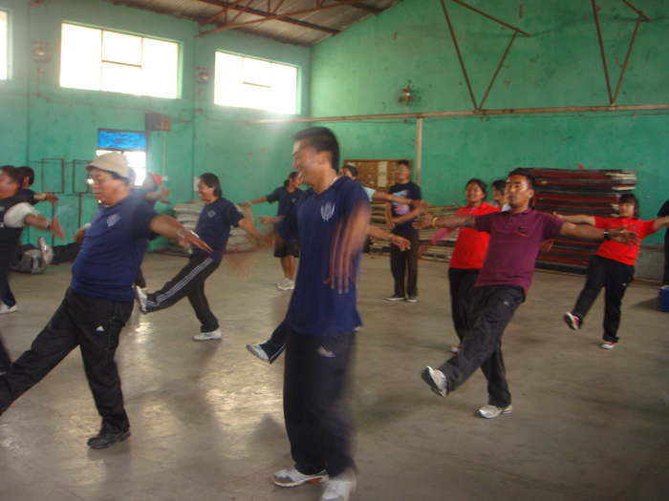
Physical Developments
General Body balance
Static postures on floor
Add: 2 feet – 1 foot – fente AV…
MINIMUM 3 sessions per week, during 4 weeks at least.
30 seconds / exercise the 1st session - 35 seconds the 2nd session - 40 seconds the 3rd session - 45 seconds the 4th session - 50 seconds the 5th session - 55 seconds the 6th session - 1 minute for the following sessions.
Pascal Colmaire – Development & Education Director of WA
Notes:
Most of the exercises shown in this set of slides “General Body Balance” have been inspired (some just copied) from the study of Doctor Pavel JURAK (Czechoslovakia)
Left: the plane – to do on both leg
Right: reverse plane – Do not do it in case of pain in the lower back - to do on both leg

Slide 18
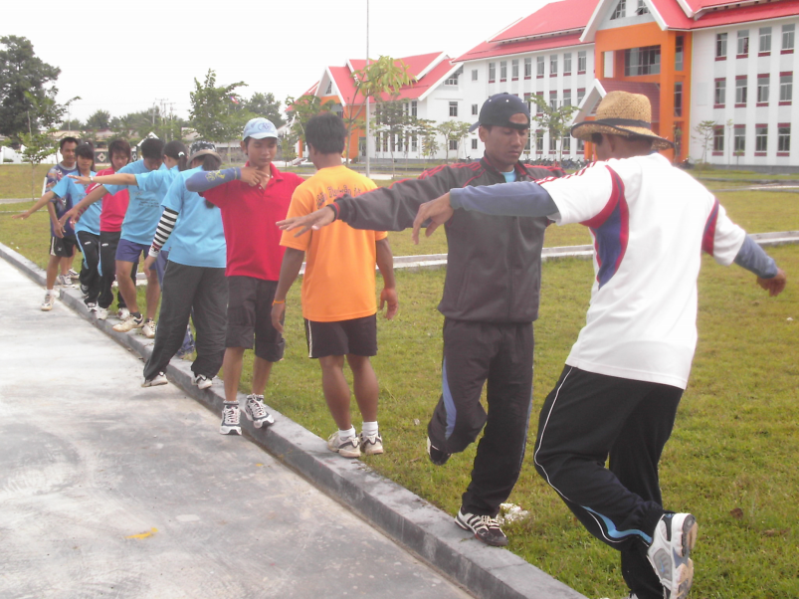
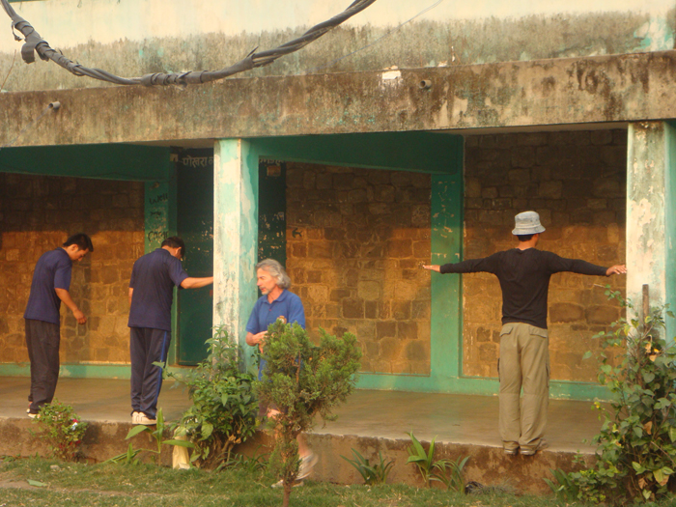
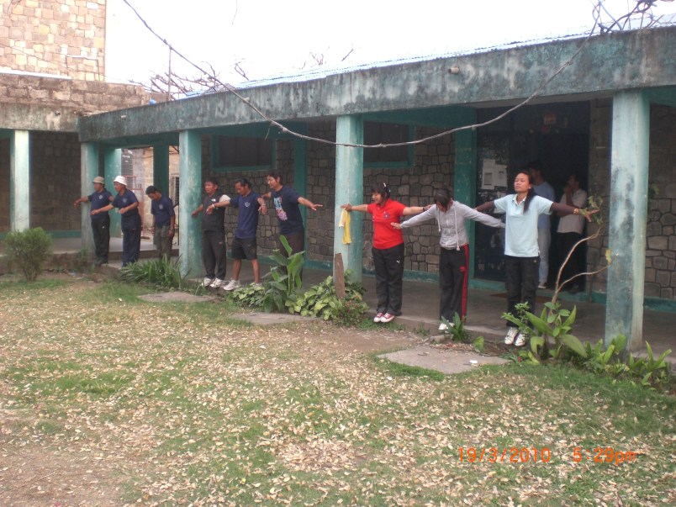
Physical Developments
General Body balance
Static postures on the edge of a step
Add:
2 feet / 1 in front of the other in both directions
Opposite picture 1
Picture 2 on the front of 1foot
Picture 3 on the back of 1foot
Same timing as the previous exercises
Pascal Colmaire – Development & Education Director of WA
Notes:
Left: To be done 4 times:
1st with the internal part of the left foot on the step
2nd with the external part of the right foot on the step – same body direction as above
Change for the opposite body direction
3rd with the internal part of the right foot on the step
4th with the external part of the left foot on the step – same body direction as above
Right: reverse plane – Do not do it in case of pain in the lower back – To be done on

Slide 19
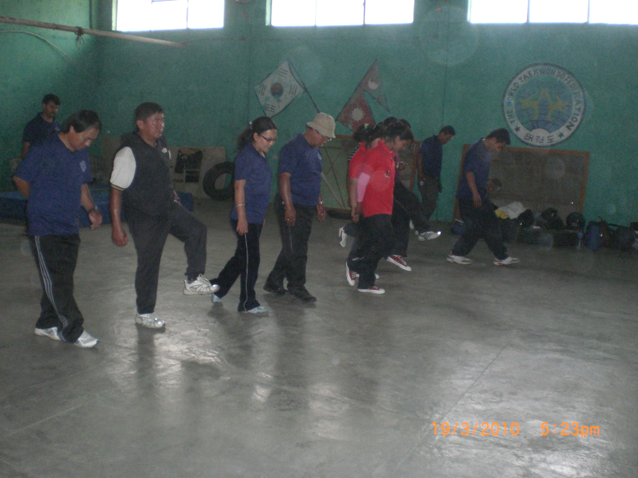
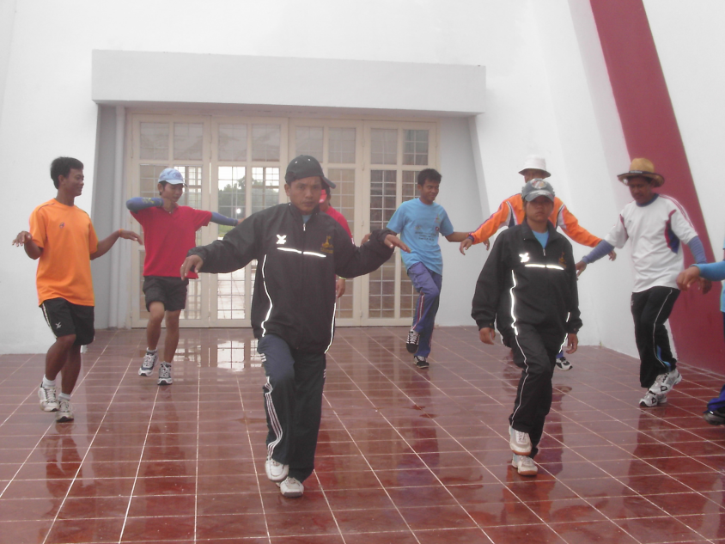
Physical Developments
General Body balance
Slow CONTINUOUS moves
2m walk in 1min.
Body rotation on 1 foot
Same timing as the previous exercises
Pascal Colmaire – Development & Education Director of WA

Slide 20
Physical Developments
General Body balance
Moving / strengthening exercises
Slow squats on toes
Slow squats on 1 foot
Add:
Twisted ankles on 2 feet
Twisted ankle on 1 foot
Same timing as the previous exercises
Pascal Colmaire – Development & Education Director of WA

Slide 21
Physical Developments
Content of the physical program
Cardiac frequency
Strength: firm trunk
Yoga or equivalent
Strength: Various types
Strength: Specific
Stretching
Body Balance: General
Body Balance: Specific
Cardio: various sources of energy
Pascal Colmaire – Development & Education Director of WA

Slide 22
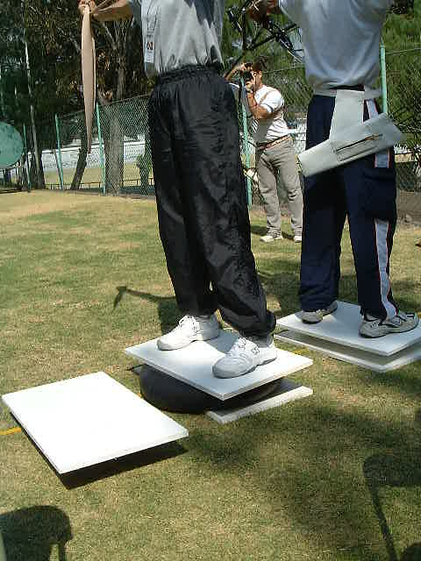
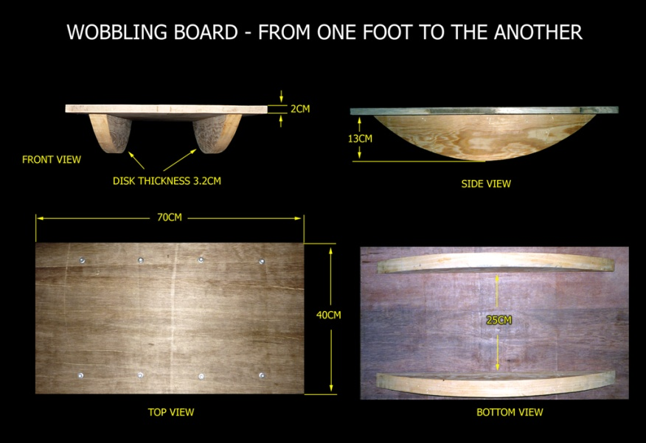
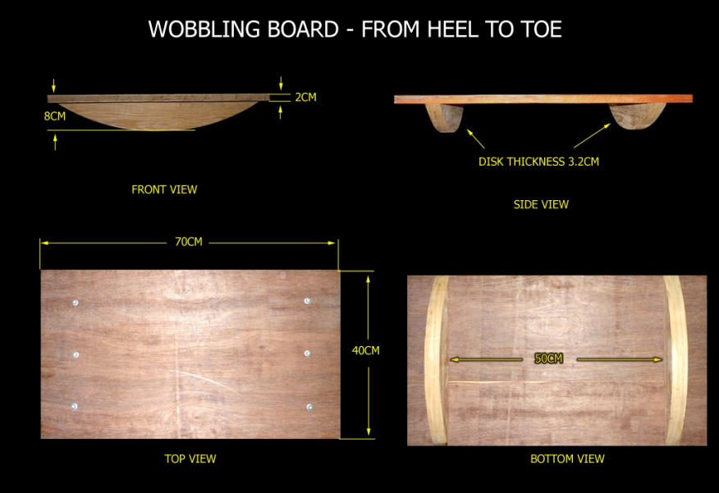
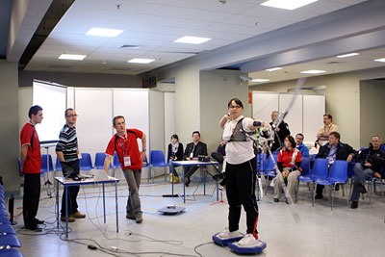
Physical Developments
Specific Body balance
Shooting from wobbling board
Add: Waffs
Pascal Colmaire – Development & Education Director of WA
Notes:
MINIMUM 3 sessions per week, during 4 weeks at least. During a session, switch to another board quite often.
40 minutes the 1st week – 45 minutes the 2nd week – 50 minutes the 3rd week – 55 minutes the 4th week – 1 hour the 5th.
Top left: left archer is shooting from a board laid on an 8” few inflated tube (480/400-8". A 10" inner tube is also acceptable)
Top middle: missing picture – archer shooting from inflated pads
2 pictures on the right: self explanatory. The coach should have several sizes of wobbling « disks ». Those disks should be screwed (not nailed) in order to easily change the wobbling difficulty. The surface of the top board should be rough (not slippery)
Bottom left: A popular measurement of the archer’s stability.

Slide 23
Physical Developments
Content of the physical program
Cardiac frequency
Strength: firm trunk
Yoga or equivalent
Strength: Various types
Strength: Specific
Stretching
Body Balance: General
Body Balance: Specific
Cardio: various sources of energy
Pascal Colmaire – Development & Education Director of WA

Slide 24
Physical Developments
General Strength
Principles - as often as possible :
Stand up / on feet
Involving more than one join/muscle
Free weight – Body weight
In control
With a stability requirement
Variety in all aspects: grip, weight/resistance, “floor”, effort….
Pascal Colmaire – Development & Education Director of WA

Slide 25
Physical Developments
General Strength
Effects of the various strengthening methods:
Load as % of the maximal | Maximum possible repetitions (slow) | Few repetitions at fast rhythm | Many repetitions at slow rhythm | Many repetitions at fast rhythm | Few repetitions at slow rhythm
85% - 100% | 95%-100% = 1 90% = 3 85% = 4-5 | Not possible at 90% of the strength | Not possible at 90% of the strength | Not possible at 90% From 80% to 90% Strength and speed | Strength
70% - 80% | 80% = 6-7 70% = 8-10 | At 80% Power. At 70% Speed | At 80% hypertrophy | At 80% resistance | Reduced improvement or reduction of strength
50% - 60% | 60% = 14-16 50% = 18-20 | At 50%-60% Hypertrophy and strength | Little effect on strength, high hypertrophy, resistance | Strength, speed and resistance | Strength and Hypertrophy
30% - 40% | >20 | Speed | Resistance | Muscular endurance | No effect
Pascal Colmaire – Development & Education Director of WA

Slide 26
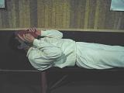
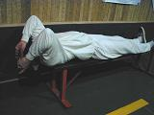
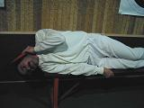
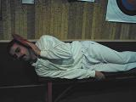
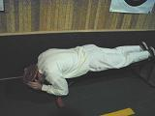
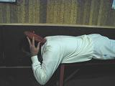
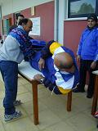
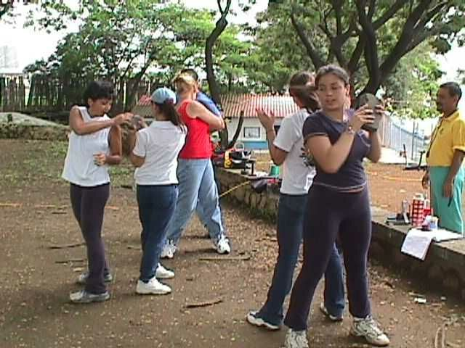
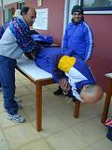
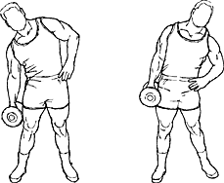
Physical Developments
General Strength
+ Various abdominals
Pascal Colmaire – Development & Education Director of WA

Slide 27
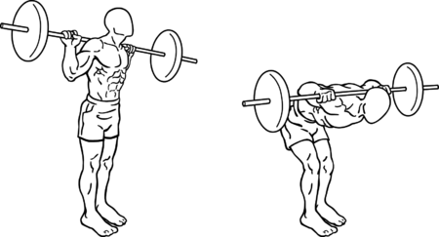
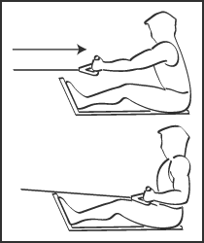
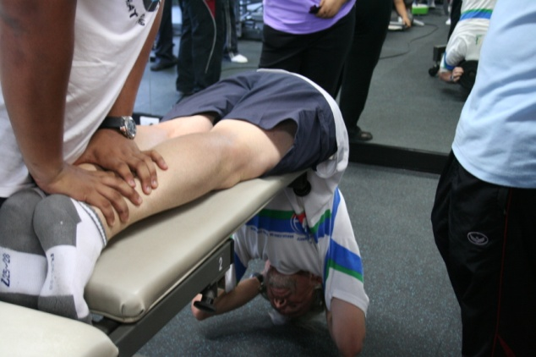
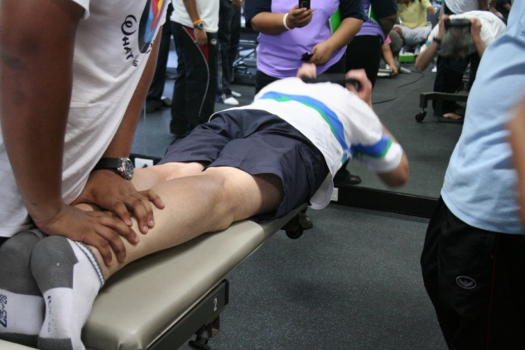
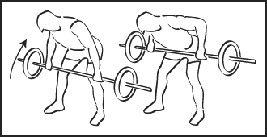
Physical Developments
General Strength
With Barbel
Pascal Colmaire – Development & Education Director of WA

Slide 28
Physical Developments
General Strength
Pascal Colmaire – Development & Education Director of WA
Notes:
To lower the shoulders

Slide 29
Physical Developments
General Strength
Standing up
Pascal Colmaire – Development & Education Director of WA

Slide 30
Physical Developments
General Strength
and reverse
Pascal Colmaire – Development & Education Director of WA

Slide 31
Physical Developments
General Strength
With back leg on a bench
Pascal Colmaire – Development & Education Director of WA

Slide 32
Physical Developments
General Strength
Pascal Colmaire – Development & Education Director of WA

Slide 33
Physical Developments
General Strength
Same in supination
Pascal Colmaire – Development & Education Director of WA

Slide 34
Physical Developments
Content of the physical program
Cardiac frequency
Strength: firm trunk
Yoga or equivalent
Strength: Various types
Strength: Specific
Stretching
Body Balance: General
Body Balance: Specific
Cardio: various sources of energy
Pascal Colmaire – Development & Education Director of WA

Slide 35
Shooting Sequence Steps
Specific Strength
Same criteria progression as in General strength
General strength | Specific Strength
More weight | More tension (#) More mass (kg)
More repetitions | More arrows
Less rests | Burst of arrows
More time under the load | Long time @ full draw
Pascal Colmaire – Development & Education Director of WA
Notes:
This table of equivalency is self-explanatory

Slide 36
Physical Developments
Specific Strength
More mass (kg)
Pascal Colmaire – Development & Education Director of WA
Notes:
Left: 2 meter long band – Women:¾” wide - Men: 1” wide
Chose a good quality elastic band (transversally stripped), you can buy it at a notion store. Adjust the length that provides the proper stiffness for the archer.
Right: We do not see well the band on the bow wrist. Recommended additional weight:
Recurve girls = ½ #
Recurve women & boys, and Compound girls = ¾ #
Recurve men and Compound women & boys = 1 #
Compound men = 1.5 #

Slide 37
Physical Developments
Specific Strength
More tension (#)
2 similar elastics as on the left, but one at each end of the riser. Elastic attached to the string
With 2# heavier bow
Without shooting
Pascal Colmaire – Development & Education Director of WA
Notes:
Simply with an heavier bow / limbs
Left: Self-explanatory. There is a possibility of shooting with such a device, but it is not very convenient.
Centre: Missing picture. It is more convenient to shoot with this setup than the one on the left.
Bottom: 2 meter long band – Women:¾” wide - Men: 1” wide. It allows to shoot
Bottom right: details showing that the band passes between the fingers. One can shoot without a sling.
Right: We do not see well the band on the bow wrist. Recommended additional weight:
Recurve girls = ½ #
Recurve women & boys, and Compound girls = ¾ #
Recurve men and Compound women & boys = 1 #
Compound men = 1.5 #

Slide 38
Physical Developments
Specific Strength
Reduced rests
Quick arrows retrieving
More arrows
Pascal Colmaire – Development & Education Director of WA
Notes:
More arrows – This criteria of specific strength development is obvious. Hence no comment, no illustration – See training.
Left picture: Dry fire device allowing burst of shots. The length of the unstretched elastic should be a couple of cm longer than the distance String elbow – string when the archer grips the string. Here this girl has combined the heavier bow with the reduced rest exercises, which is not mandatory.
Right (and White) description: Self explanatory.

Slide 39
Physical Developments
Specific Strength
Reduced rests
Burst of arrows
Shooting distance : 18 m or 25 or 30
Target face : Regular for the shooting distance (40, 60, 80cm)
Number of arrows : 8 per end
Time allocated : 2’ 30”/ end
Time allocated to retrieve and score the arrows: 1’ 30”
Select the accuracy zone.
An assistant/scorer is strongly recommended. Score the arrows in the shooting order for analysis.
Goal: at least 6 ends with up to arrows outside the accuracy zone
More arrows: per end and total
Pascal Colmaire – Development & Education Director of WA
Notes:
More arrows – This criteria of specific strength development is obvious. Hence no comment, no illustration – See training.
Left picture: Dry fire device allowing burst of shots. The length of the unstretched elastic should be a couple of cm longer than the distance String elbow – string when the archer grips the string. Here this girl has combined the heavier bow with the reduced rest exercises, which is not mandatory.
Right (and White) description: Self explanatory.

Slide 40
Physical Developments
Specific Strength
Long time @ full draw
10 – 15”
20” rest
24 repetitions
Pascal Colmaire – Development & Education Director of WA
Notes:
Select the archer’s accuracy zone on a regular target face for your shooting distance. Adjust the sight
3 arrows / 12” means to shoot 3 arrows and “hold” each one during 12 seconds before release
At full draw, breathe quietly and constantly. Take all the rest you need between arrows and ends. After the exercise, analyse the deviation of your impact (if any), within each end, and along the exercise.
During the exercise, record the location of each impact, for instance as follow: “7/2” which means 7 points at 2 o’clock.
At the end of the 2 pyramids, analyse your impacts as explained over the two next slide

Slide 41
Physical Developments
Specific Strength
Long time @ full draw
5th end: 1 arrow / 25”
4th end: 2 arrows / 20” 6th: 2 arrows / 20”
3rd end: 3 arrows / 16” 7th end: 3 arrows / 16”
2nd end: 4 arrows / 12” 8th end: 4 arrows / 12”
1st end: 5 arrows / 8” 9th end: 5 arrows / 8”
Archers strives to get the clicker and release as close as possible to the allocated time.
Compound: to be done in combination with heavier bow or/and mass
Pascal Colmaire – Development & Education Director of WA
Notes:
Select the archer’s accuracy zone on a regular target face for your shooting distance. Adjust the sight
3 arrows / 12” means to shoot 3 arrows and “hold” each one during 12 seconds before release
At full draw, breathe quietly and constantly. Take all the rest you need between arrows and ends. After the exercise, analyse the deviation of your impact (if any), within each end, and along the exercise.
During the exercise, record the location of each impact, for instance as follow: “7/2” which means 7 points at 2 o’clock.
At the end of the 2 pyramids, analyse your impacts as explained over the two next slide

Slide 42
Physical Developments
Specific Strength
Long time analyse
First half versus second half of the “Pyramid”
If decreased scores or/& a deviation of the impacts in the second half, it could be a lack of endurance/stamina. If so, consider more arrows per session, as well as to reduce the rest time between arrows and ends (meaning less talk and more shooting for most of us…)
Shots after a “short” hold, versus “long hold”.
If decreased scores or/& a deviation of the impacts during long hold consider other or additional alternatives: bow weight reduction - return to the gym - emphasise of the shooting strength development program...
More arrows per session and less rests is still valid.
Pascal Colmaire – Development & Education Director of WA
Notes:
Self explanatory.
The archery coach should figure out what the archer does differently when getting tired.

Slide 43
Physical Developments
Specific Strength
Long time with heavier bow
5 more pounds
Hold 10-15”
20” rest
20 repetitions
No collapse
Pascal Colmaire – Development & Education Director of WA
Notes:
Self explanatory.
The archery coach should figure out what the archer does differently when getting tired.

Slide 44
Physical Developments
Specific Strength
Other:
Locally focussed effort
Elbow string harness
20” hold
30” rest
5 – 20 repetitions
Option:
add 2 – 10# elastic resistance between riser and bow string
Pascal Colmaire – Development & Education Director of WA
Notes:
Self explanatory.
The archery coach should figure out what the archer does differently when getting tired.

Slide 45
Physical Developments
Specific Strength
Other
Extra Draw Length
Locally focussed effort
Click then extend 1 extra cm
Same string mark on chin
20” rest
20 repetitions
Smooth and control
Click then extend 1 extra cm
Same string mark on chin
20” rest
20 repetitions
Smooth and control
Pascal Colmaire – Development & Education Director of WA
Notes:
Self explanatory.
The archery coach should figure out what the archer does differently when getting tired.

Slide 46
Thank you… Ready to answer your questions!
Pascal Colmaire – WA Development & Education Director

