Slide 1
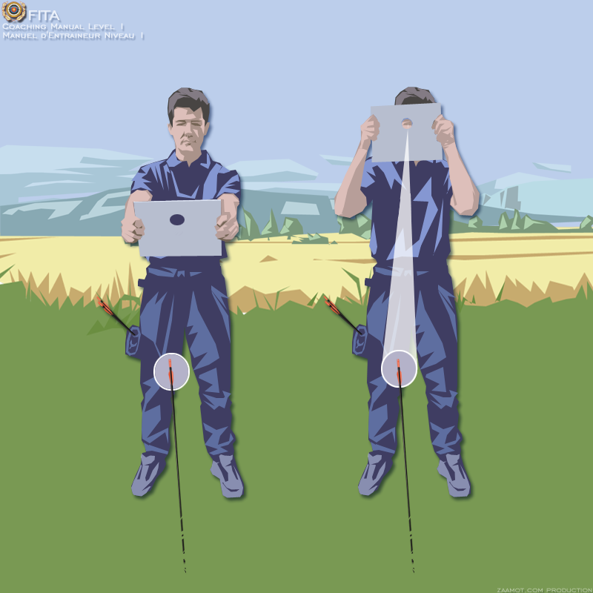
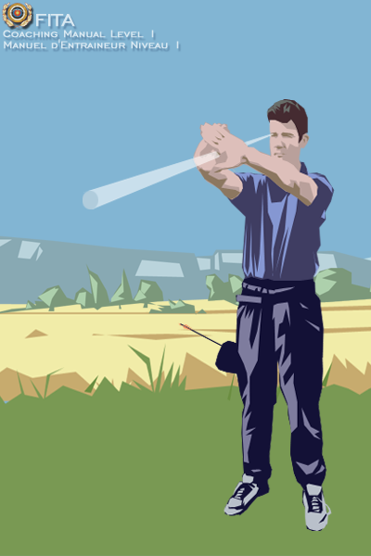
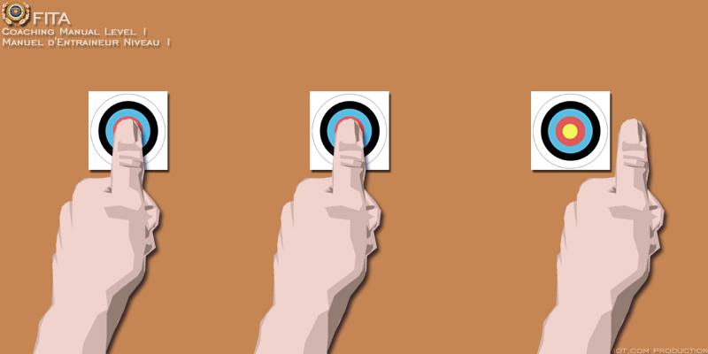
Instruction – Shooting side
Eye?
Or …
Hand?
Pascal Colmaire – Training and Development Coaching Director of WA
Notes:
Before teaching novices, the coach must know their shooting side

Slide 2
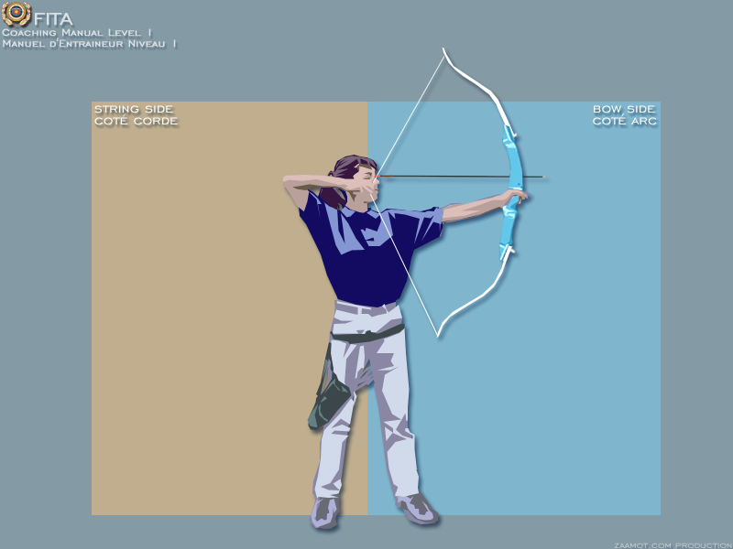
Instruction
TERMINO
L
O
G
Y
String Side
Bow Side
Pascal Colmaire – Training and Development Coaching Director of FITA

Slide 3
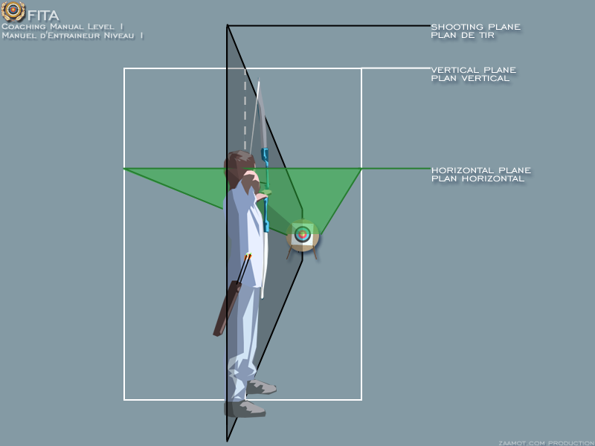
Instruction
TERMINO
L
O
G
Y
Pascal Colmaire – Training and Development Coaching Director of FITA

Slide 4
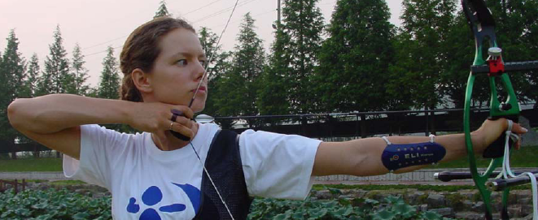
Instruction
Draw line or Draw Force Line
TERMINO
L
O
G
Y
Straight imaginary line through
pivot point on the bow and pulling point on the string
Pascal Colmaire – Training and Development Coaching Director of FITA
Notes:
Mathematical straight line. Line through two moving points.

Slide 5
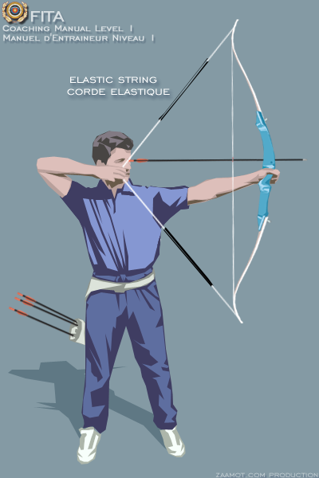
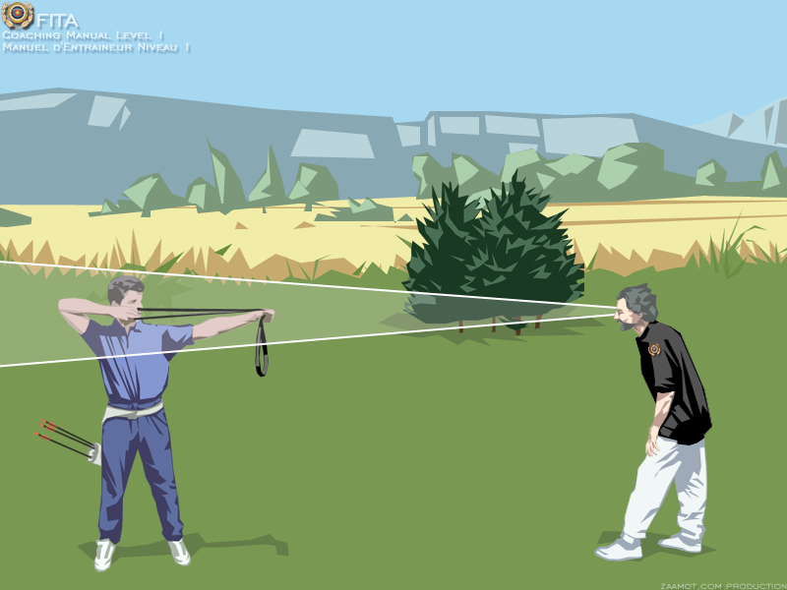
Instruction
Basic Instruments
Pascal Colmaire – Training and Development Coaching Director of FITA

Slide 6
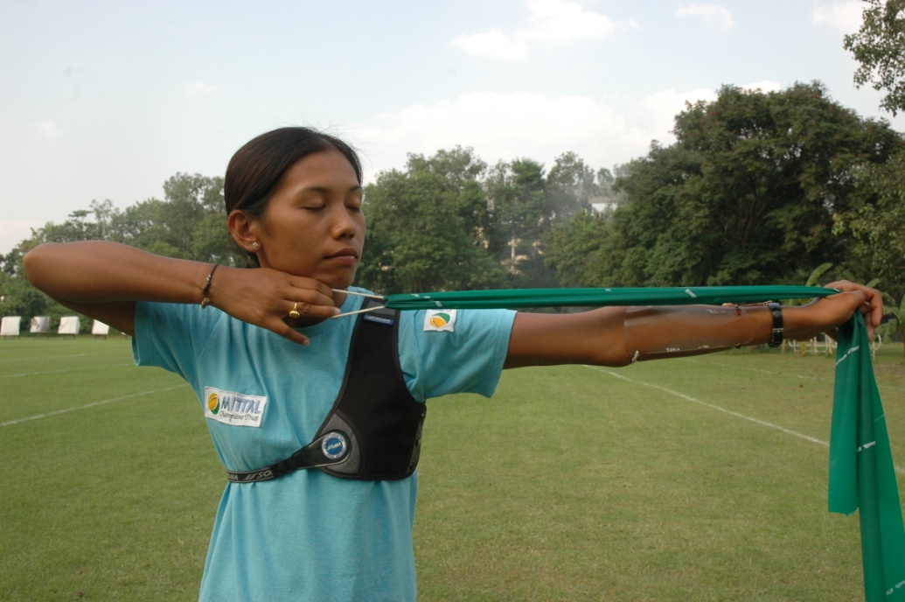
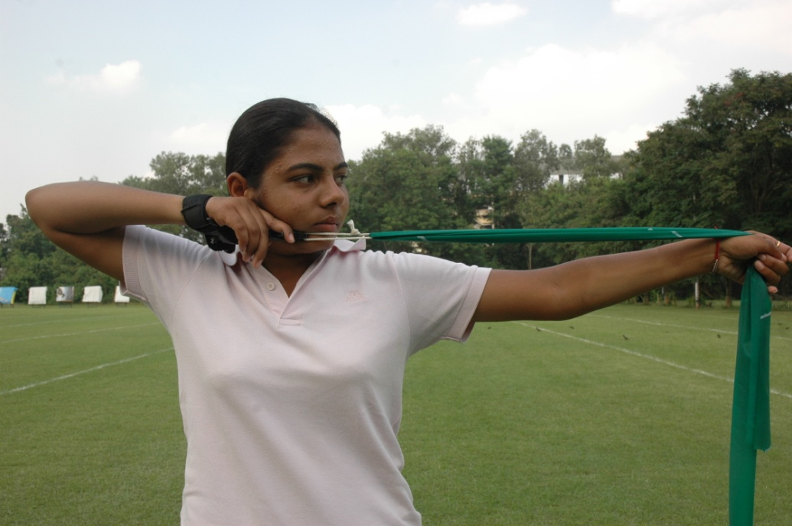
Instruction
Basic Instruments
Pascal Colmaire – Director de Entrenamiento y Desarrollo de FITA

Slide 7
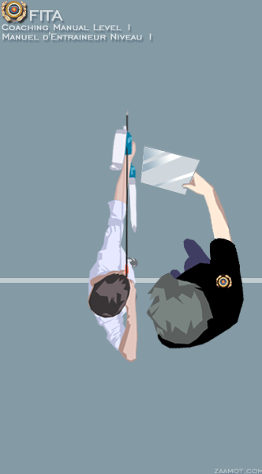
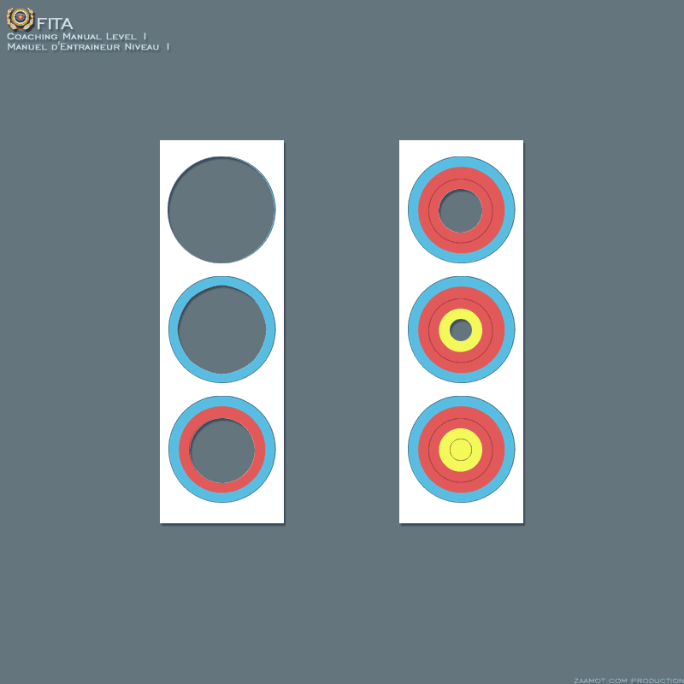
Instruction
Basic Instruments
Pascal Colmaire – Training and Development Coaching Director of FITA

Slide 8
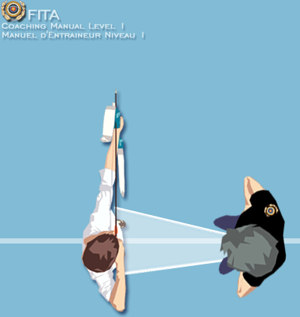
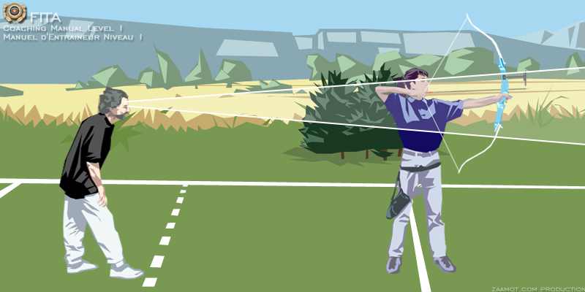
Instruction
Observe
Pascal Colmaire – Training and Development Coaching Director of FITA

Slide 9
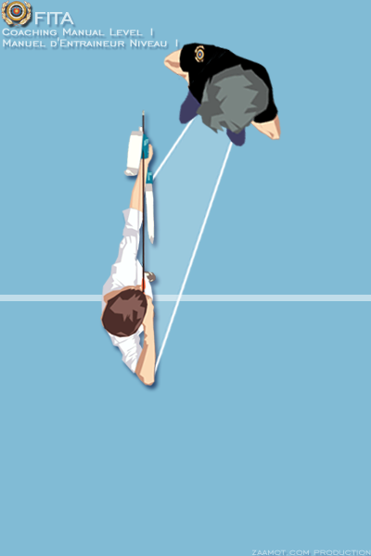
Instruction
Observe
Pascal Colmaire – Training and Development Coaching Director of FITA

Slide 10
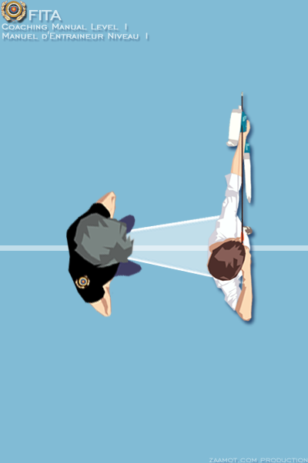
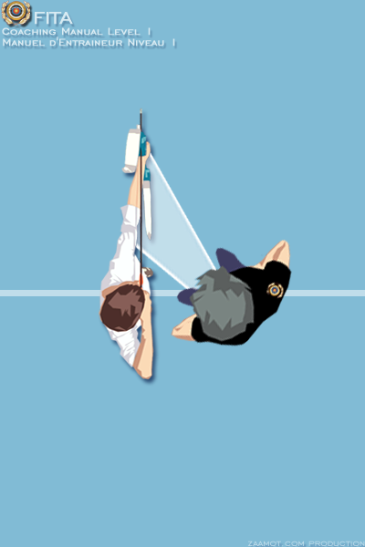
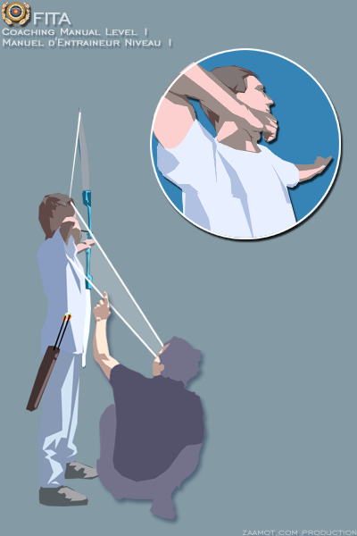
Instruction
Observe
Pascal Colmaire – Training and Development Coaching Director of FITA

Slide 11
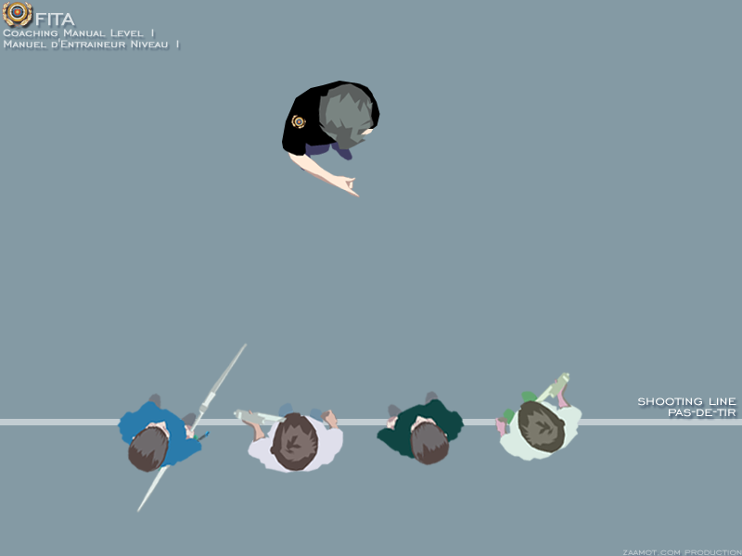
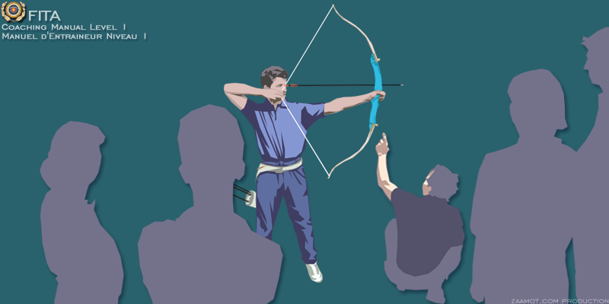
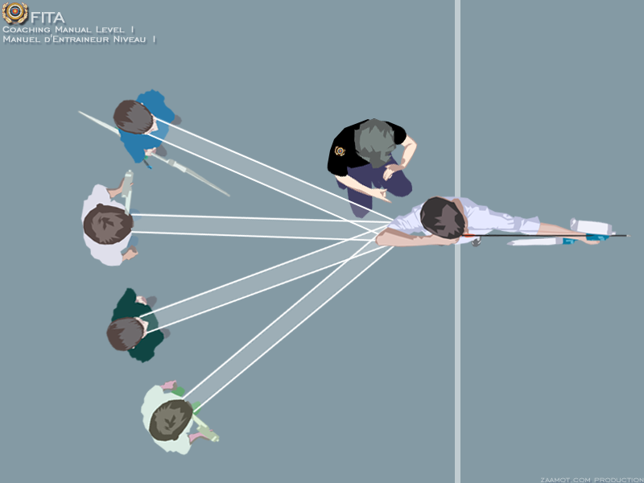
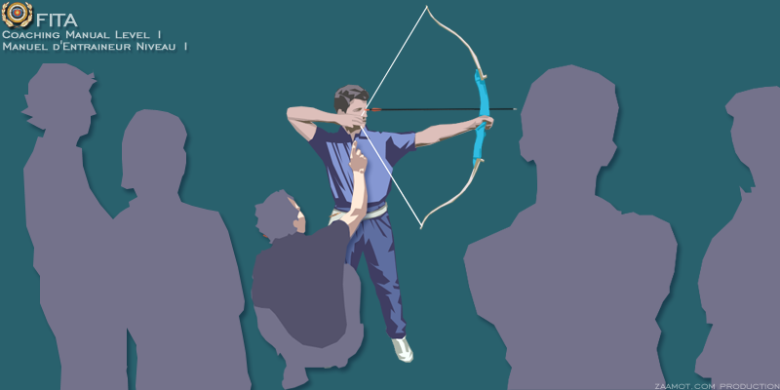
Instruction
Instruction and explanation
Pascal Colmaire – Training and Development Coaching Director of FITA

Slide 12
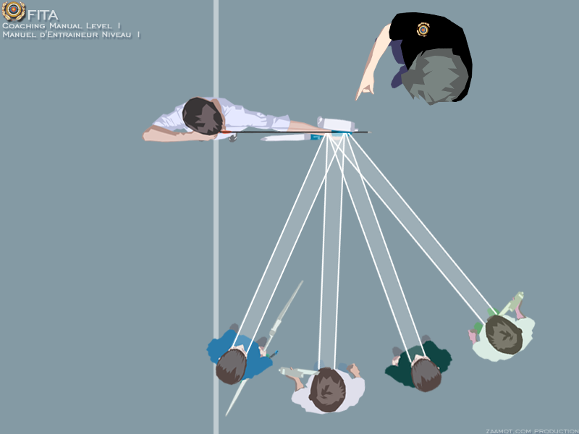
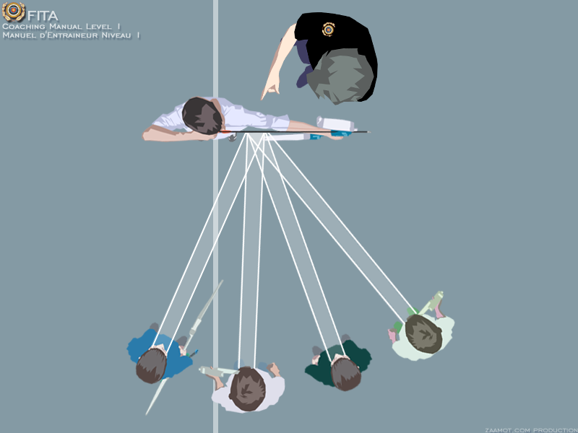
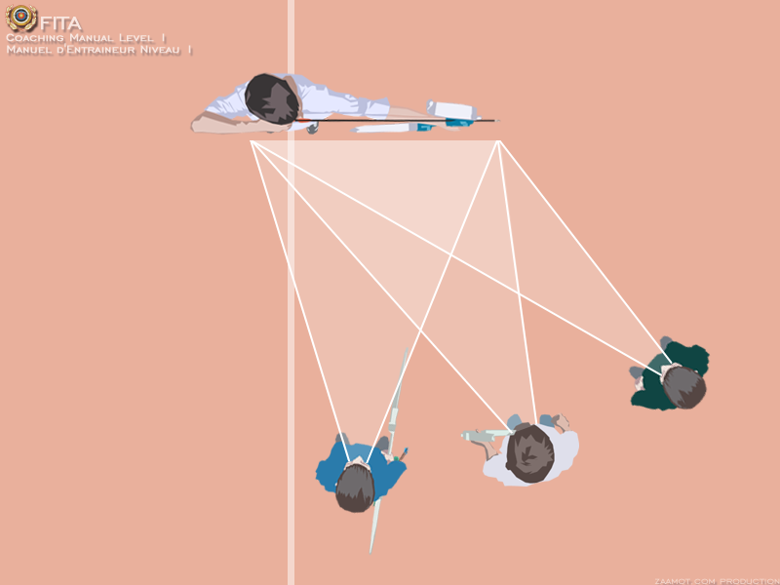
Instruction
Where to stand
Make
observing
and
Pascal Colmaire – Training and Development Coaching Director of FITA

Slide 13
Instruction
Plan of a Class
1 coach for 6 to 12 beginners
The sections in a typical session in Archery are:
Preparation
Welcome
Warming Up
Review of the previous session
Teaching of an ability.
Introduction: Demonstration and simulation.
Assimilation of the ability by the increment of the difficulties: Auto-observation, sensation of discovery, shooting without a target, shooting at empty targets.
Evaluation of resistance (of ability):
Shooting with a target, a duel, counting points or a game.
Return to more "regular" and controlled shots;
Evaluation of the session – equipment storage.
Pascal Colmaire – Training and Development Coaching Director of FITA

Slide 14
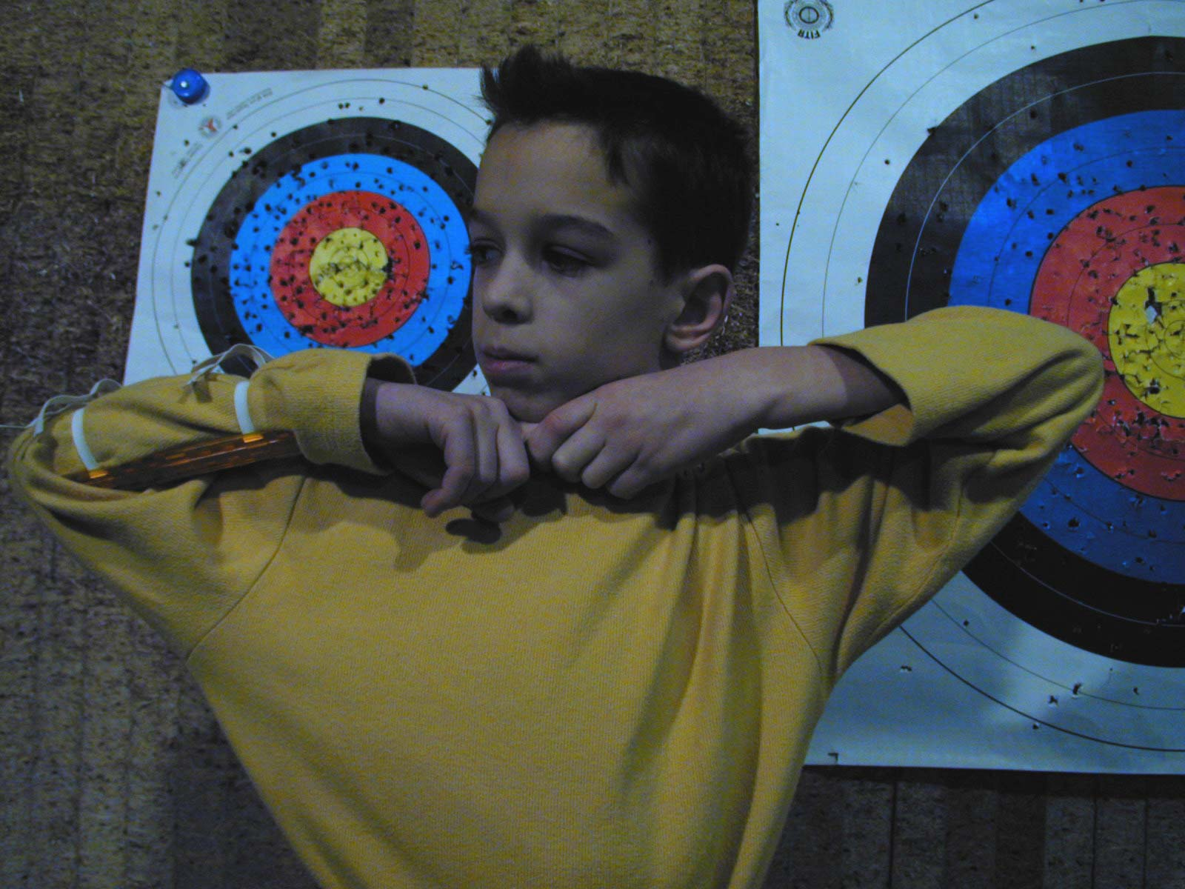
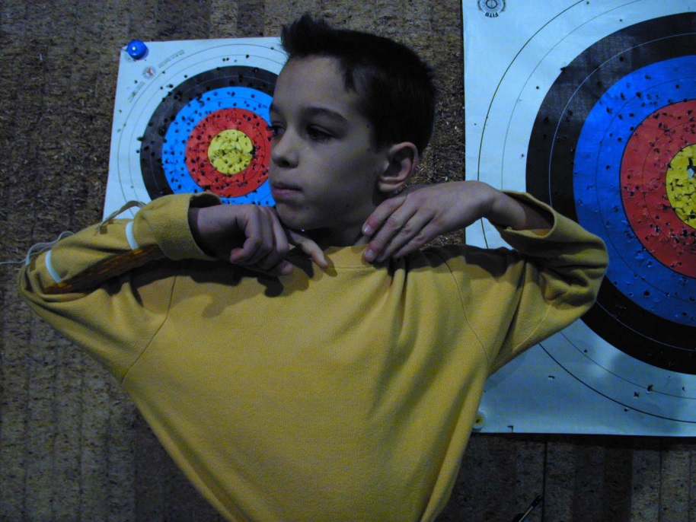
Mimics
Pascal Colmaire – Training and Development Coaching Director of WA

Slide 15
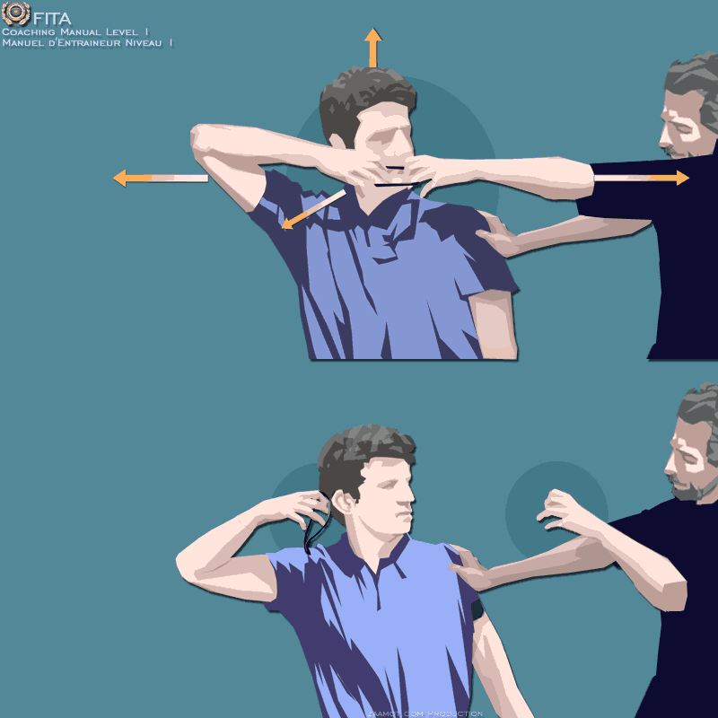
Assisted Mimics
Pascal Colmaire – Training and Development Coaching Director of WA

Slide 16
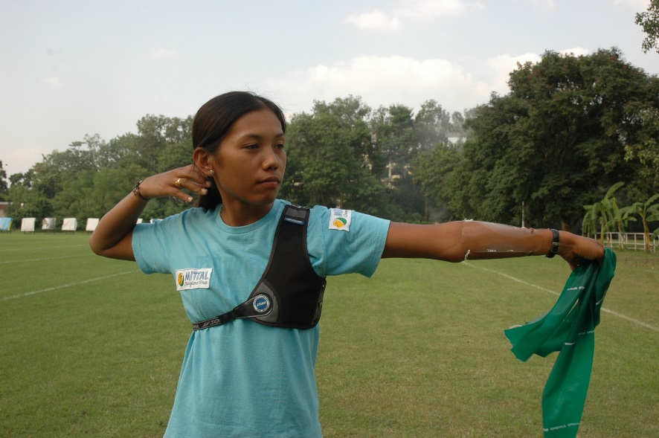
Simulations with elastic resistance
Pascal Colmaire – Training and Development Coaching Director of WA

Slide 17
Simulations with elastic resistance on a bow
Device allowing dry fire
Arrow to be removed from the picture
Pascal Colmaire – Training and Development Coaching Director of WA

Slide 18
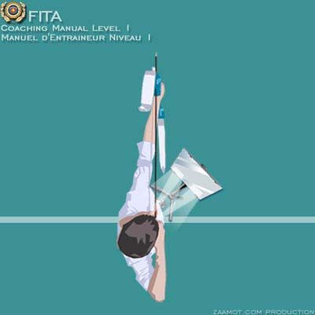
Self observed simulations / elastic on bow
Elastic string on the bow allowing dry fire
Arrow to be removed from the picture
Pascal Colmaire – Training and Development Coaching Director of WA

Slide 19
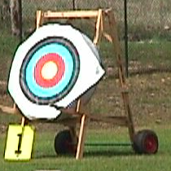
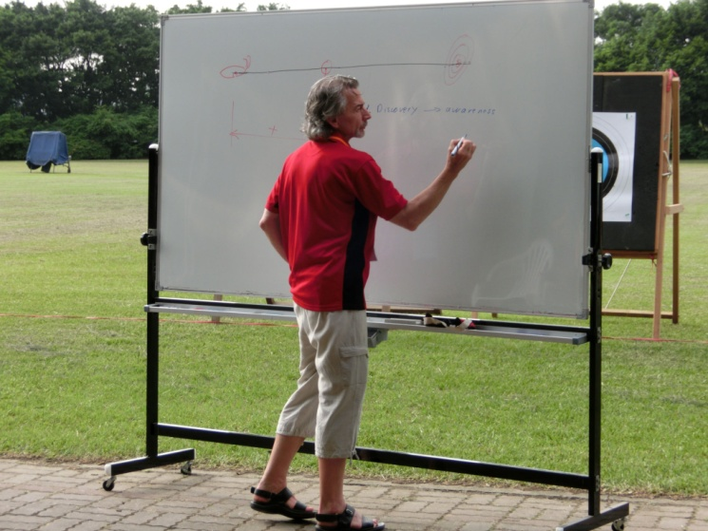
Instruction – Teaching items
Movable targets
Cut-out faces
Board
Pascal Colmaire – Training and Development Coaching Director of WA
Notes:
Movable targets for easy & fast change of shooting distance, also for the hidden target exercise
Cut-out target faces for integration of the aiming to the proper shooting execution – See the standard teaching process
White or black board for obvious reason

Slide 20
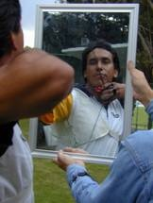
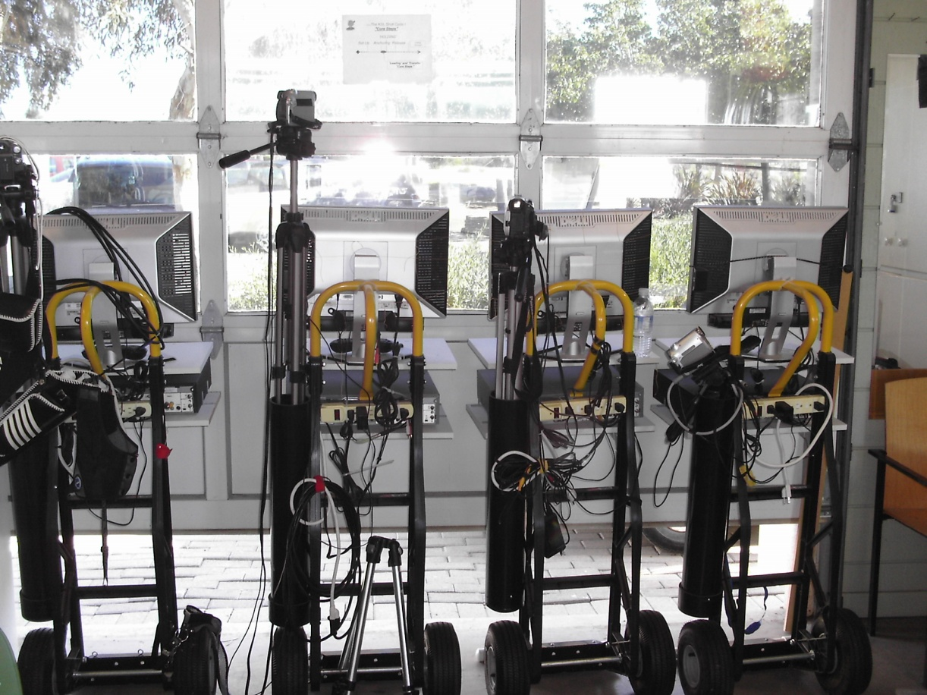
Instruction – Teaching items
Visual feedback
Pascal Colmaire – Training and Development Coaching Director of WA
Notes:
For visual feedback: Mirrors and video units
Mirrors can also be on movable stands

Slide 21
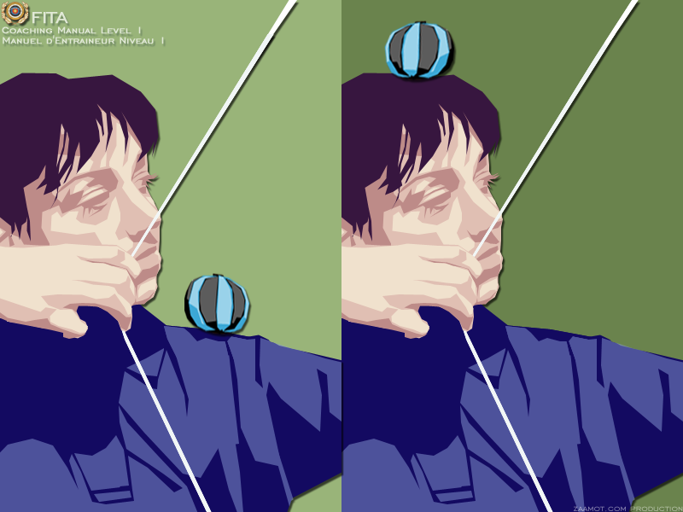
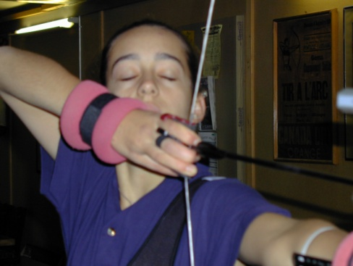
Instruction – Teaching items
Juggling balls
Weight bands
Pascal Colmaire – Training and Development Coaching Director of WA
Notes:
The Juggling balls must be soft and filled with sand or seeds or fine gravels…
Weight bands from several weights are required

Slide 22
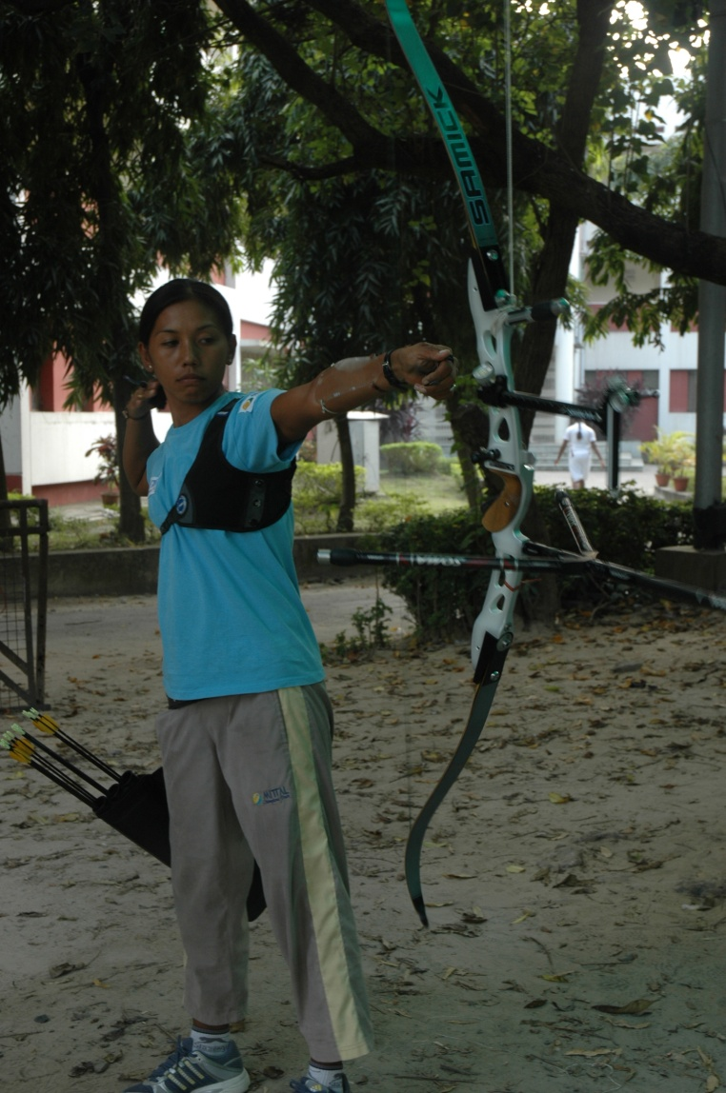
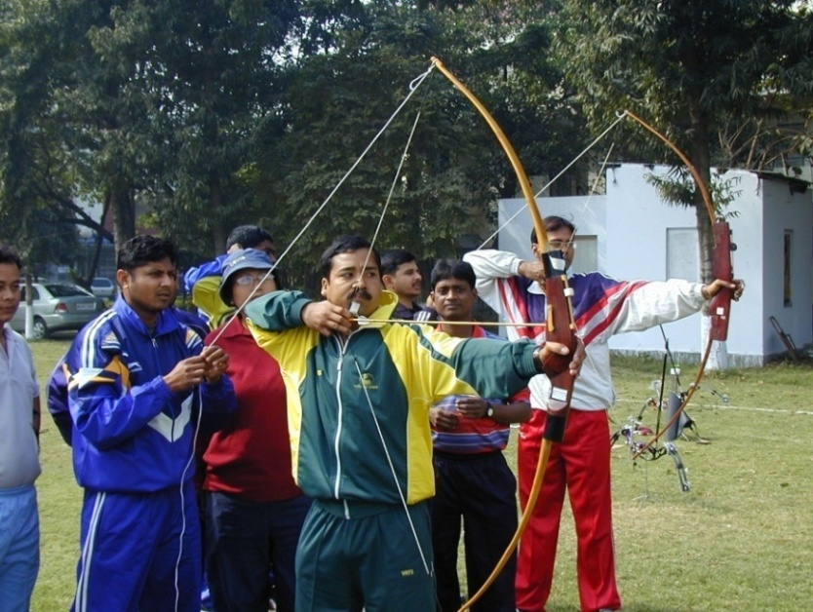
Instruction – Teaching items
Strings - Ropes
Add horizontal line
Pascal Colmaire – Training and Development Coaching Director of WA
Notes:
For suspending the bow in order to teach the proper use of the bow sling / bow hand
For various alignment checking's

Slide 23
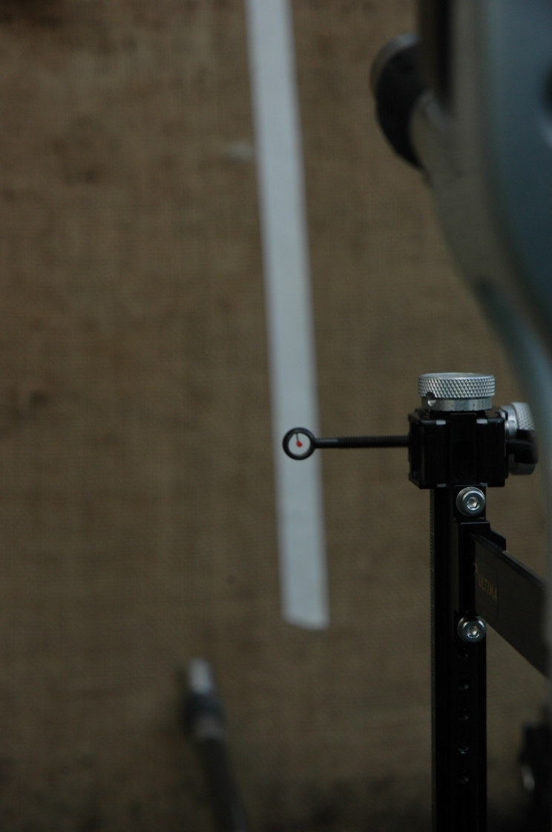
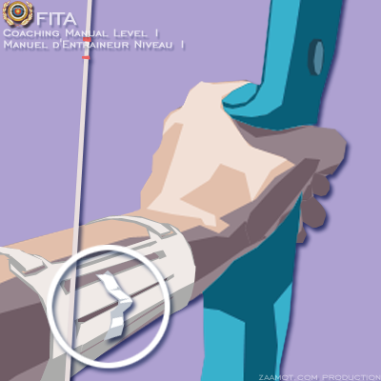
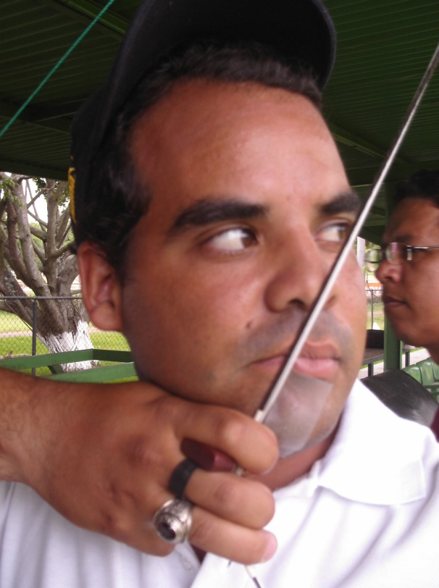
Instruction – Teaching items
Tapes
Pascal Colmaire – Training and Development Coaching Director of WA
Notes:
Regular and hypodermic tape

Slide 24
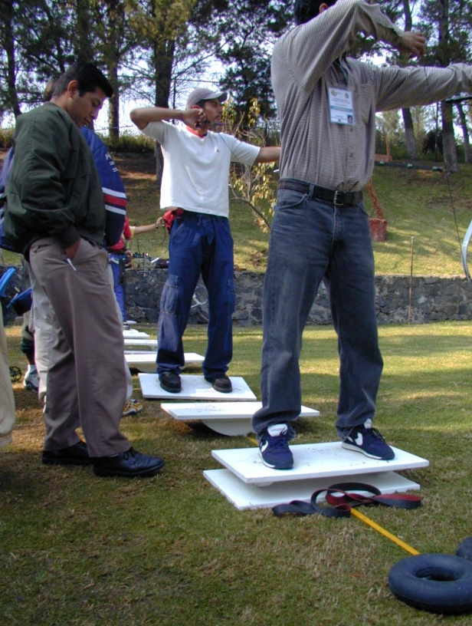
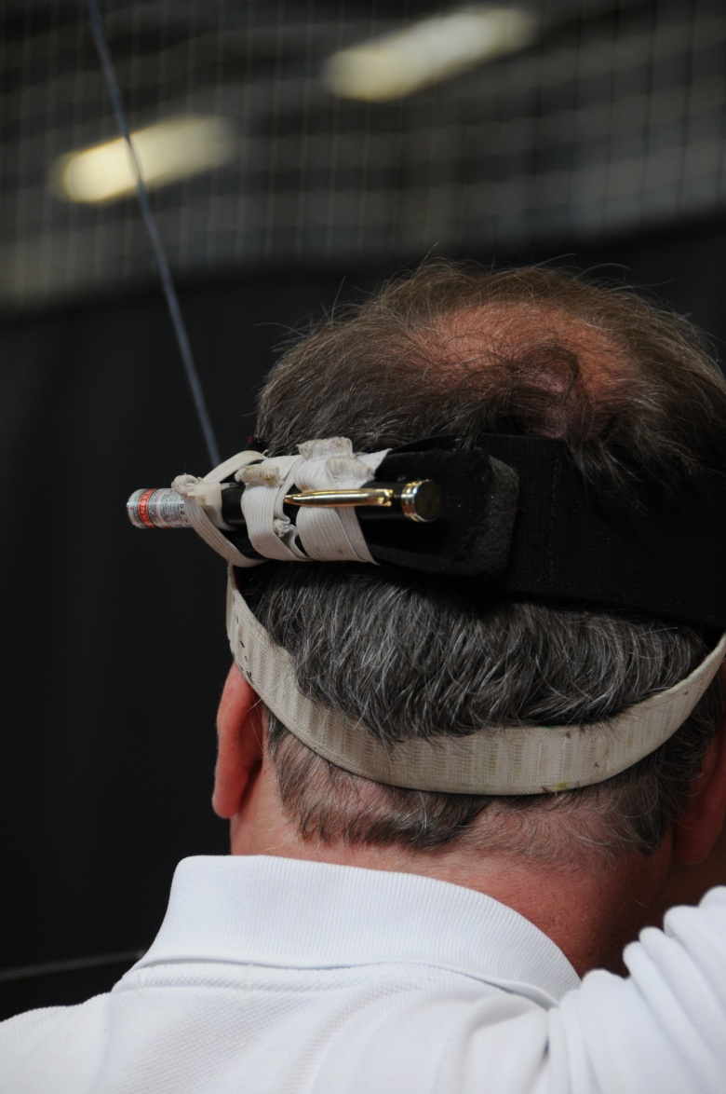
Instruction – Teaching items
Unbalanced
supports
Laser Head
Remloc
Pascal Colmaire – Training and Development Coaching Director of WA
Notes:
Many unbalanced supports can be used in order to improve the body balance: wobbling boards (in various directions), board lied on a inner tube (from various diameter), inflated cushions (with more or less air pressure)….
Remloc laser head to check the maintaining of the extension axis while getting the clicker.

Slide 25
Instructions
Observe
Pascal Colmaire – Training and Development Coaching Director of WA
Notes:
Ask the participants what they can observe from the above observation spots. Complete their answers if necessary

Slide 26
Instructions
Observe
Pascal Colmaire – Training and Development Coaching Director of WA
Notes:
Ask the participants what they can observe from the above observation spots. Complete their answers if necessary

Slide 27
Instructions
Observe
Pascal Colmaire – Training and Development Coaching Director of WA
Notes:
Ask the participants what they can observe from the above observation spots. Complete their answers if necessary

Slide 28
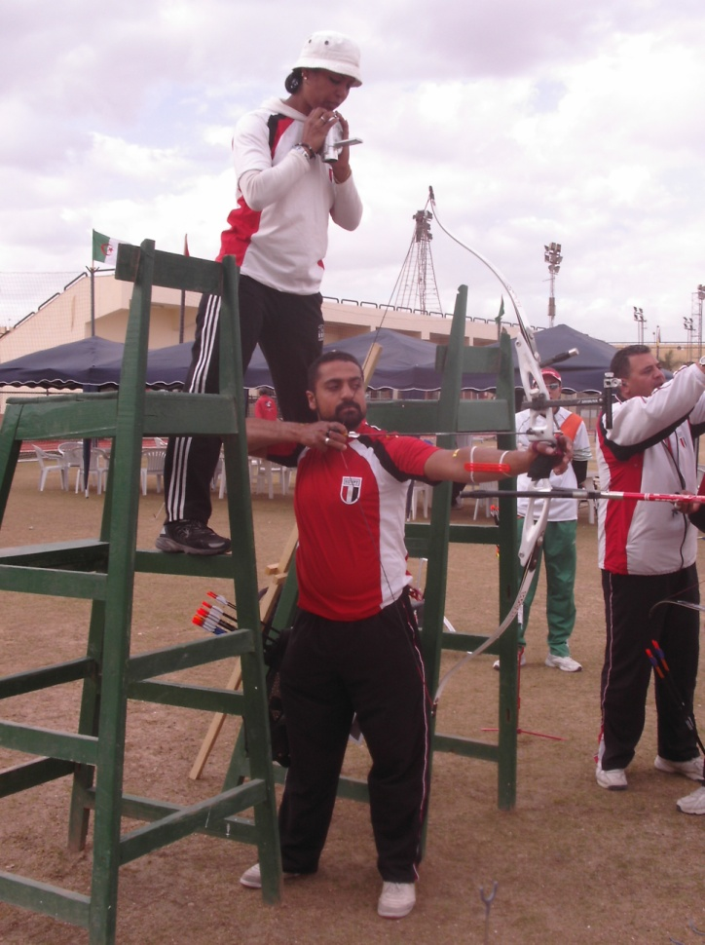
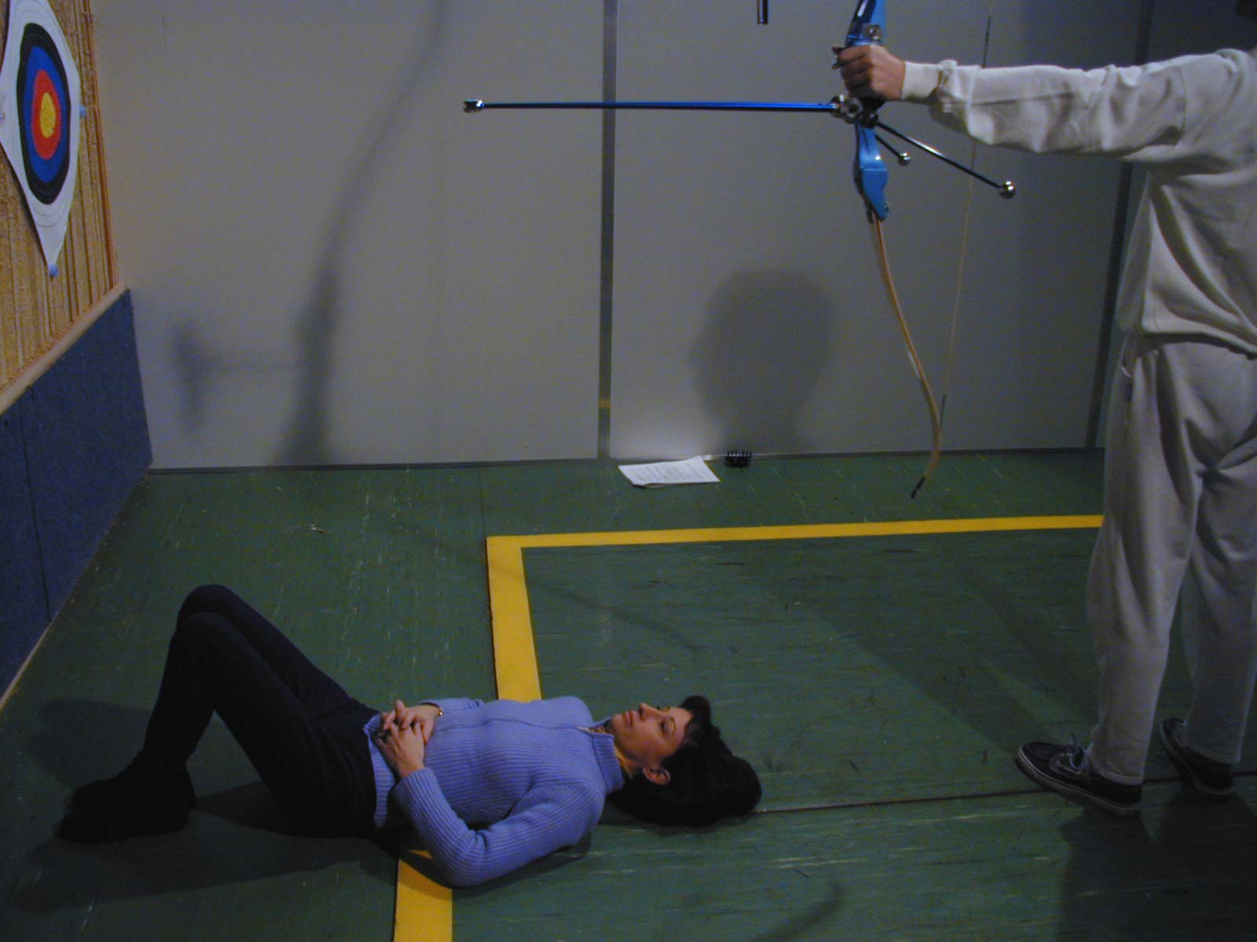
Instructions
Observe
Pascal Colmaire – Training and Development Coaching Director of WA
Notes:
Ask the participants what they can observe from the above observation spots. Complete their answers if necessary

Slide 29
Instructions
To be changed
Instruction and explanation
To be changed
Pascal Colmaire – Training and Development Coaching Director of WA
Notes:
Always give the instruction just before shooting, for instance when archers are on the shooting line
Pictures top right & bottom right must be changed, because the coach should face the students

Slide 30
Instructions
Where to stand
Make
observing
and
Pascal Colmaire – Training and Development Coaching Director of WA

Slide 31
Instruction
Plan of a Class
1 coach for 6 to 12 beginners
The sections in a typical session in Archery are:
Preparation
Welcome
Warming Up
Review of the previous session
Teaching of an ability.
Introduction: Demonstration and simulation.
Assimilation of the ability by the increment of the difficulties: Auto-observation, sensation of discovery, shooting without a target, shooting at empty targets.
Evaluation of resistance (of ability):
Shooting with a target, a duel, counting points or a game.
Return to more "regular" and controlled shots;
Evaluation of the session – equipment storage.
Pascal Colmaire – Training and Development Coaching Director of WA
Notes:
Self explanatory

Slide 32
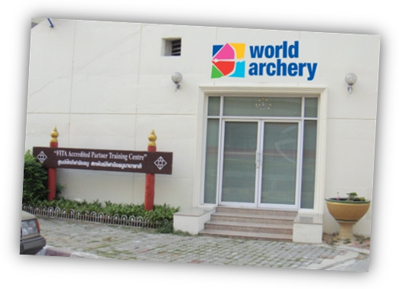
Thank you… Ready to answer your questions!
Pascal COLMAIRE – WA Development & Education Director

Slide 33
Shooting side selection
Eye?
Or …
Hand?
Pascal Colmaire – Training and Development Coaching Director of WA
Notes:
Before teaching novices, the coach must know their shooting side

