Slide 1
What is coaching?
What is
Archery Coaching ?
Notes:
This set of slides intends to clarify what is coaching in archery.

Slide 2
What is coaching?
WA concept
Help the archers
in their personal development
Through: observation/analysis, feedback, plan and individualization
Other possible concepts
Educate the archers to implement the “selected school”
…
Pascal COLMAIRE – WA Development & Education Director
Notes:
There are 2 concepts:
#2: the coach must teach what has been decided by his organisation: a “school”, while the archer has just to implement/execute
#1: the coach assists/collaborates with the archer in order to find out the best efficiency. In this concept:
Help: Coach is not a handler nor a rough- handler, but a partner in the couple archer-coach
Personal development: People are different in their body, learning process...
Observation/Analyse: of the athlete’s technique, behaviour, progresss... in order to evaluate the strengths and the weaknesses
Feedback: oral, visual... to involve the archer in the analyse to complete the coach’s analyse and to draft a plan
Plan: process setting what to do from the analyse
Individualisation: at any step of the archer’s development in either their feedback preference, learning process, technical efficiency...

Slide 3
What is coaching?
To get progressing athletes, we need progressing coaches
Level
Athlete
Coach level 1
Entry
Time
0 1 2 3 4 5
3
Notes:
3
ENTRY LEVEL Archer and COACH:
Archers are novices, recreational archers, unskilled archers...
We do not know yet (and often the archer as well) the wish, will, ambition… of the beginner: to reach high level? Just practice recreationally?
The level 1 coach must teach the most common technical basic archery skills, since we do not know which archery division and discipline(s) the novice will shoot in the future.
At the end the archer may have more know-how than the coach, and being coaches by a higher skilled coach could become a necessity.

Slide 4
What is coaching?
To get progressing athletes, we need progressing coaches
Level
Athlete
Coach level 1,2
Intermediate
Entry
Time
0 1 2 3 4 5
4
Notes:
4
Profile of the intermediate (level 2) archer:
those who have completed the level 1
many recreational archers, even if they attend to some competitions, they want to spend their free time for a hobby consisting to shoot arrows from a bow. They are not so disposed to develop other sport related skills during their free time such as running, strengthening.... Most of them need the help of the coach to become a specialist of one bow division and a pair of archery disciplines; hence the level 2 coach needs a specialized education in this bow division and these archery disciplines.
those who are not enough skilled to reach the elite level
Sometimes the same coach looks after the archers of the level 1 and 2 (or 2 and 3), but sometimes 2 different coaches do it. Consistency in coaching processes among these different coaches better allows the archer to keep progressing because it avoids any adaptation to new coaching concepts.

Slide 5
What is coaching?
To get progressing athletes, we need progressing coaches
Level
Elite
Athlete
Intermediate
Coach level 1,2,3
Entry
Time
0 1 2 3 4 5
5
Notes:
5
The elite archers strives to get the best score and results and the highest number of victories as possible. Nowadays many of them are professional (full time, or part-time), benefit from school/work arrangements…
Very seldom the same coach looks after the archers of the level 1, 2 and 3; usually a full time professional coach - or a part-time / contracted professional coach - looks after the elite archers. Hence almost all elite archers experiment several coaches along their career. Consistency in coaching processes among these different coaches better allows the archer to keep progressing because it avoids any adaptation to new coaching concepts.

Slide 6
What is coaching?
To get progressing athletes, we need progressing coaches
Level
Elite
Athletes
Intermediate
Coach level 1,2,3
Entry
Time
0 1 2 3 4 5
6
Notes:
6
THREE PROFILES OF ARCHERS AND COACHES IN ONE GRAPH
Same as the 3 previous graphs, but in one.

Slide 7
What is coaching?
Help the archers in their own development
High
Contribution of the athlete
Contribution of the level 3 coach
Contribution of the level 2 coach
Contribution of the level 1 coach
Low
Performance level of the archer
Beginner Intermediate Elite
Pascal COLMAIRE – WA Development & Education Director
Notes:
Same as previous slide by through a different graphical representation

Slide 8
Coaching
Operational Aspect
Development of Abilities
versus Time
The coach should know the abilities to develop in various areas and the processes to teach them.
(Technician & Teacher)
Season Availability
(Time Administrator
& Coordinator)
Develop and implement a Training Plan
Pascal COLMAIRE – WA Development & Education Director
Notes:
Training an athlete is to develop various skills of this athletes (technical, physical, psychological, also some equipment…) during a limited period of time (number of years, before a team change…). The scheduling of these developments is set in a training plan, something that is learnt at the level 3.

Slide 9
Coaching
Operational Aspect
Time Axis
D
E
v
E
L
O
P
M
E
N
T
S
See Training Plan (Level 3)
Pascal COLMAIRE – WA Development & Education Director
Notes:
Hence a training plan is simply a chart with two entries:
the duration on one axis
The developments on the program on the other axis
It is a programming exercise covered at the level 3 of the coaching education.

Slide 10
What is coaching?
The archery coach should help the archer with:
Environment: safety, social, fun, fair-play…
Sport specific developments:
Physical
Technical
Psychology
Equipment
Pascal COLMAIRE – WA Development & Education Director
Notes:
The archery coach must provide the above “things”.
For equipment the coach must teach some knowledge and know-how’s

Slide 11
What is coaching?
Coach’s tasks / Environment
Safety:
Rules & Awareness
Maintain - Compliance
Involve
Fair-Play:
Ethics
Clean & healthy sport
Pascal COLMAIRE – WA Development & Education Director
Notes:
At all levels, the coach must warranty a safe and fair practice

Slide 12
What is coaching?
Coach’s tasks / Environment
Social:
Integration
Team building
Animator
Administration of human resources :
Coach, Parents, Athlete, Volunteers, Sponsors, Judges, Organizers…
Fun:
Enjoyable and/or changing sessions
Pascal COLMAIRE – WA Development & Education Director
Notes:
Also at all levels, but probably more important with novices (hence level 1), these 3 human related criteria of the environment of practice must also be ensured.

Slide 13
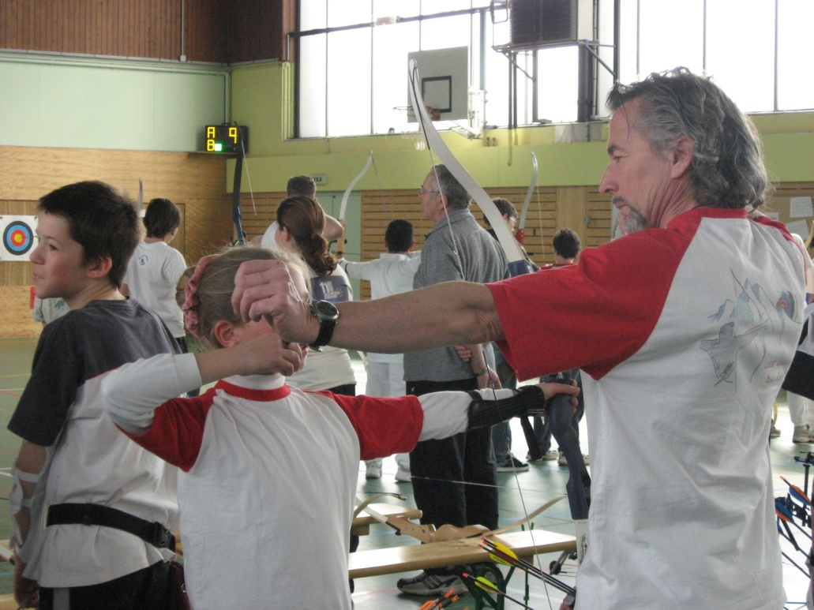
What is coaching?
Coach’s tasks / Developments
Sport specific expertise level:
Technical knowledge (technique & equipment)
Experience
Up to date
Rules knowledge:
Reference person
Sport Generic competencies:
Fitness knowledge & expertise
Psychology knowledge & expertise
Pascal COLMAIRE – WA Development & Education Director
Notes:
Some of the expertises expected from the coach

Slide 14
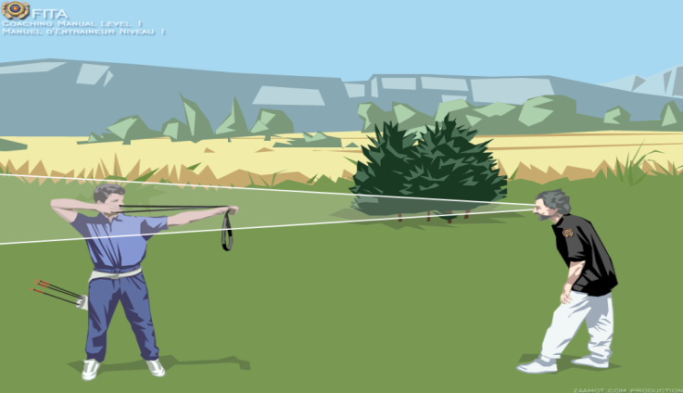
What is coaching?
Coach’s tasks / Developments
Teaching skills:
Provide good basic & generic skills through:
Simple/clear instructions
Efficient methods of teaching
Sharp observation
Appropriate exercises & corrections
Positive feedback
…
Self-evaluation
Pascal COLMAIRE – WA Development & Education Director
Notes:
From the level 1 the above basic and generic coaching skills are required. Of courses they are also required at other levels.

Slide 15
What is coaching?
Coach’s tasks / Developments
Teaching and management choices:
Where / Facilities: choice, arrangements, improvements,
With what / Equipment: buy, allocation (adapted), maintenance….
How / Session: Distance (short for level 1), Exercise,
Number of arrows,…
When / Frequency, order and duration of the sessions. Number and dates of the tournaments….
Time administrator: skills development over time
Pascal COLMAIRE – WA Development & Education Director
Notes:
Some choices the archery coach has to do. Coaching is linked to decision making, see next slide

Slide 16
What is coaching?
Coach’s tasks / Developments
Choices making:
According to the directives of the organization / The coach “applies” or adapts, the archers execute
By the coach him-herself/ The archers execute
Involving the archers to the choices / The archers and the coach collaborate
Suitability / Pending their respective psychological profile, any of the above principle can be useful and chosen
Pascal COLMAIRE – WA Development & Education Director
Notes:
Decision making

Slide 17
What is coaching?
Role of the Coach
To get progressing athletes, we need progressing coaches
Initial training
Continuing education
Experience(s)
Auto evaluation
It takes time (+/- 7 years) and efforts to become a good archer
It takes time (how long?) and efforts to become a good coach
Pascal COLMAIRE – WA Development & Education Director
Notes:
In white, the requirement for any progression in quality coaching
The rest of this slide is self-explanatory

Slide 18
What is coaching?
Role of the Coach
Personal Qualities:
Availability
Dedication
Sincerity – Objective - Honesty - Integrity
Group Attitude
Respectful – Fair – Responsible -
….
Pascal COLMAIRE – WA Development & Education Director
Notes:
In short we should be perfect!

Slide 19
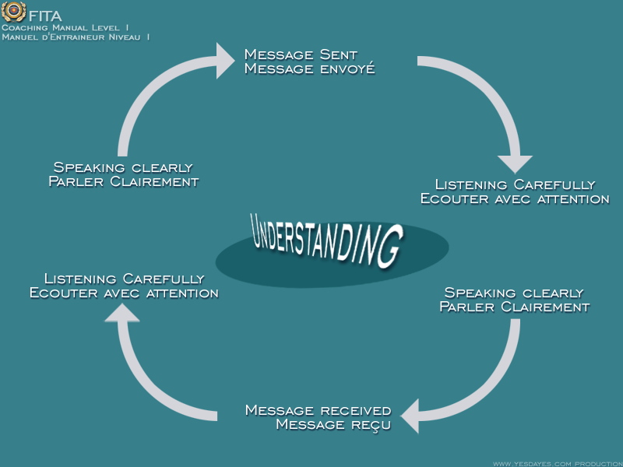
What is coaching?
Role of the Coach
COMMUNICATION
Communicate with your students
Ability to Converse and Control
Listen
Clarity
Quickness
Gestures
Enthusiasm
Repetitive Phrases
Humor
Pascal COLMAIRE – WA Development & Education Director
Notes:
The graphic highlights the 2 ways role of the transmitter and receiver in an efficient communication.
In White some criteria of a good communicator

Slide 20
Loss of information
Communicating?
100%
What you want to say
What you can say
What you really say
What the student hears
When the student listens carefully
What the student understands
What the student keeps in mind
What the student can recall
What the student can practically use
10%
Pascal COLMAIRE – WA Development & Education Director
Notes:
This graphic is self explanatory. The consequence of the high risk of lost of information is stated in the next slide

Slide 21
What is coaching?
Role of the Coach
COMMUNICATION
TELL ME……..I FORGET
SHOW ME……..I REMEMBER
INVOLVE ME ……..I UNDERSTAND
Pascal COLMAIRE – WA Development & Education Director
Notes:
Consequence of the previous slide:
Verbal coaching is not enough: « But I already told him… »
Demonstrations are important in coaching
It is mandatory to allow the archer to test/experiment

Slide 22
Teaching bases:
What is coaching?
Safety first
Skill selection & Goal setting
Demonstrations & instructions
Teaching method & supports
Shooting: Distance, Target, # arrows, duration
Observation & Feedback
Assistance to do correctly
Individualisation
Pascal COLMAIRE – WA Development & Education Director
Notes:
Steps of the standard coaching process
On the line 5 “Shooting” are listed the elements the coach can play with

Slide 23
Coaching
Questionnaire before training
In addition to the other questions like level, goals, exams …
How good do you want to be?
How much time will it require?
How much time can you invest?
What are your strengths?
What are your weaknesses?
Detect the archer’s profile
Pascal COLMAIRE – WA Development & Education Director
Notes:
List of questions the coach can ask to the athlete prior their collaboration.
Detect the profile of each athlete because if we consider only 2 different profiles:
Hard-working athlete
Competition/challenge oriented athlete
The coach could ask to the hard-working athlete to shoot a while (45 minutes) eyes closed or at a blank but, while it would be a disaster with a competition oriented athlete. This latest type of persnality will shoot without anxy focuss after few minutes of such a “boring” training situation
Hence we must detect the profile of each person in order to choose the way of training them

Slide 24
What is archery about?
Archers Task
Ballistic Concept= Repeat:
The position of the arrow in space
Archer’s Task = Repeat with perfection:
The position of all the parts of their body in relation to the target
And
The propulsion force applied to the arrow
The technique to release the string correctly
Various Techniques can be used very effectively in archery, since the quality of the repetition is more important than the optional techniques used.
Simple Technique = Easy to repeat = EFFICIENCY
Pascal COLMAIRE – WA Development & Education Director
Notes:
Self explanatory slide
Accuracy in the target = accurate repetitions of the archers

Slide 25
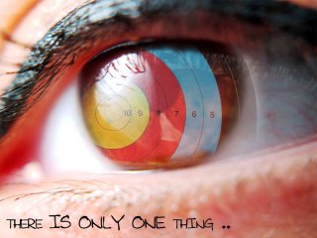
What is archery about?
Archers Task
V
I S
S G
U N
A I
L
E
E
F
Pascal COLMAIRE – WA Development & Education Director
Notes:
Many beginners thinks that if they release when their aiming reference point is in the centre of the target, they should hit this centre. But experimented archers knows that it is not enough, we should also have good/usual feelings:
Feeling to be in the same posture (same form)
Feeling of providing the same efforts, the same level of muscular tension (effortless)
Feeling of a good body balance
Psychological feelings as well: same relaxation level, same level of confidence, of positivity...

Slide 26
Entraîner
Tâches de l’archer
S
N
O
V
I
I
T
S
A
U
N
E
S
L
Pascal COLMAIRE – FITA Development & Education Director

Slide 27
What is archery about?
Archers Task
V
I
S G
U R N
A E I
L
E E
E A
F S
E
Pascal COLMAIRE – WA Development & Education Director
Notes:
Ideally the release should happen when the archer:
See good visual references such as sight (or arrow point) moving few and gently around the centre of the target (this is the main visual reference while the following ones are in a peripheral/secondary vision), the string is aligned, the bow is vertical….
Has good perceptions such as:
Feeling to be in the same posture (same form)
Feeling of providing the same efforts, the same level of muscular tension (effortless)
Feeling of a good body balance
Psychological feelings as well: same relaxation level, same level of confidence, of positivity...
But even when the release happens during the visual/perception coordination, the result in the target is not ensured – see the following slide

Slide 28
What is archery about?
Archers Task
V
I
S G
U R N
A E I
F O L L O W - T H R O U G H
E E
E A
F S
E
Pascal COLMAIRE – WA Development & Education Director
Notes:
The release should happen without any change in the visual/feelings coordination, in positive words it is called “follow-through”, a perfect continunity of all the activities (phyiscal*, visual, mental, respiratory, balance..) from a little before the release until a little after the release; hence during the propeling step of the arrow.
* The only change for archer gripping the string with their finger is the muscular activity of the finger flexors (Absolutely no change for archers using a mechnic release)

Slide 29
What is archery about?
Archers Task
V g
I n
S i
U l
A e
R E L E A S E
f
Shooting only with visual references will not guarantee a good arrow.
Beware of « Target Panic »
Pascal COLMAIRE – WA Development & Education Director
Notes:
Getting use to release only from the visual references; hence without any references on the perceptions/feelings, often introduces a target panic

Slide 30
What is archery about?
Archers Task
Definition: The archer, repeating their positions and efforts to look for maximum stability, releases the string during the period of coordination between their visual references, kinesthetic and psychological aspects without alternating from this coordination (subconscious release).
Variations of the Archers Task:
Finger and no clicker
Clicker
Releases the string mechanically without trigger
Releases the string mechanically with trigger
Pascal COLMAIRE – WA Development & Education Director
Notes:
Self explanatory slide

Slide 31
What is archery about?
Archer’s Abilities
Psychological:
Relaxation, positivism, Concentration, know how to enter and stay in their “zone” – Mental Stability
Focus and Visual Discipline / Visual Stability
Kinesthetic Sensations
Static Stability - Body balance
Dynamic Stability - Strength during complete stretching.
Technical and automatic “Know-How”
Pascal COLMAIRE – WA Development & Education Director
Notes:
List of archer’ skills helping to make a training plan (see how to make a training plan, on one axis of the chart/plan the coach must list the skills to be developed)

Slide 32
What is archery about?
Archer’s Technique
Anything can work, as long as its repeated concisely
1- Repetition of the forces of the bow and the string
“Spring Effect of the Bow” constant forces of the archer.
It should give the archer exact sensations repeat exactly the forces of the bow and in the body
Activity with apparatus user relaxed upon use of accessory;
The strength does not come from the arms it comes from the back and the shoulders;
2 – Compromise between the line of force (fatigue and bow action) and the direction of the string
How to determine the magnitude of the draw length?
The technique is basically biomechanical
Pascal COLMAIRE – WA Development & Education Director
Notes:
Self explanatory slide
A bow acts as a spring on the archer’s body, making him/her collapsing/creeping
In any discipline using a device, the first thing the coach strive to achieve from the beginner is to get more relaxed on this device: a racquet, ski, horse, …

Slide 33
What is archery about?
Archer’s Task
See:
“Guide for making a Training Plan”
For Level 3
Pascal COLMAIRE – WA Development & Education Director
Notes:
WA Development and Education department has developed a guide to make a training plan. At the level 3 this guide is used to educate the archery coaches

Slide 34
Thank you… Ready to answer your questions!
Pascal COLMAIRE – WA Development & Education Director

